Slide 1

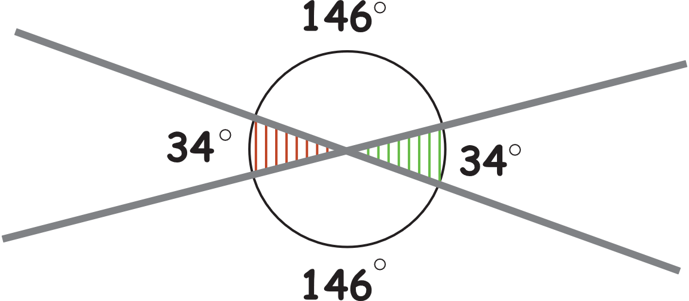
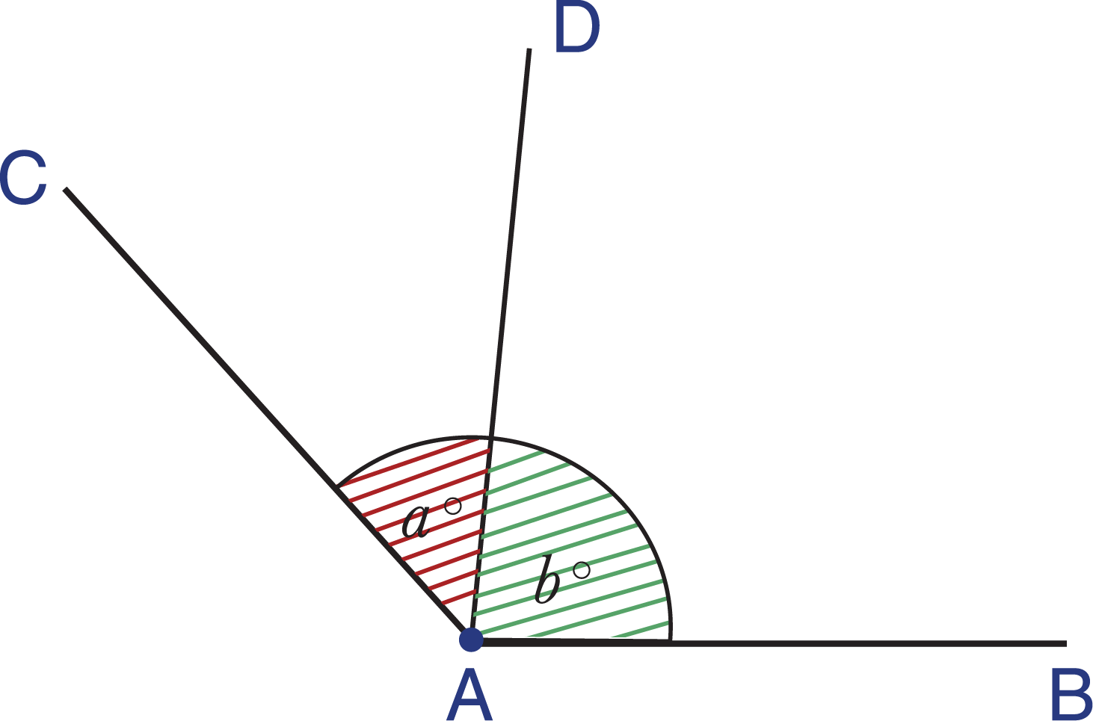

  Adjacent Angles – Vertically Opposite Angles
      Grade 6- Chapter 7
This material is made possible with the support of the American people through the United States Agency for International Development (USAID). The content is the sole responsibility of QITABI 2 and does not necessarily reflect the views of USAID or the United States Government. This material was developed by the Joint Academic Department (JAD) and the Equipment Installations and Material Support Bureau (EIMSB) at the Centre of
Educational Research and Development (CRDP) with the support of USAID-funded QITABI 2 project.

Slide 2
  Specific Learning Objective 2:
At the end of this session, you will be able to define
and recognize two vertical angles.
Notes:
Teaching suggestions:
At the end of this session, you will be able to define and recognize two vertical angles.

Slide 3

Understanding
Conceptual Understanding

Slide 4
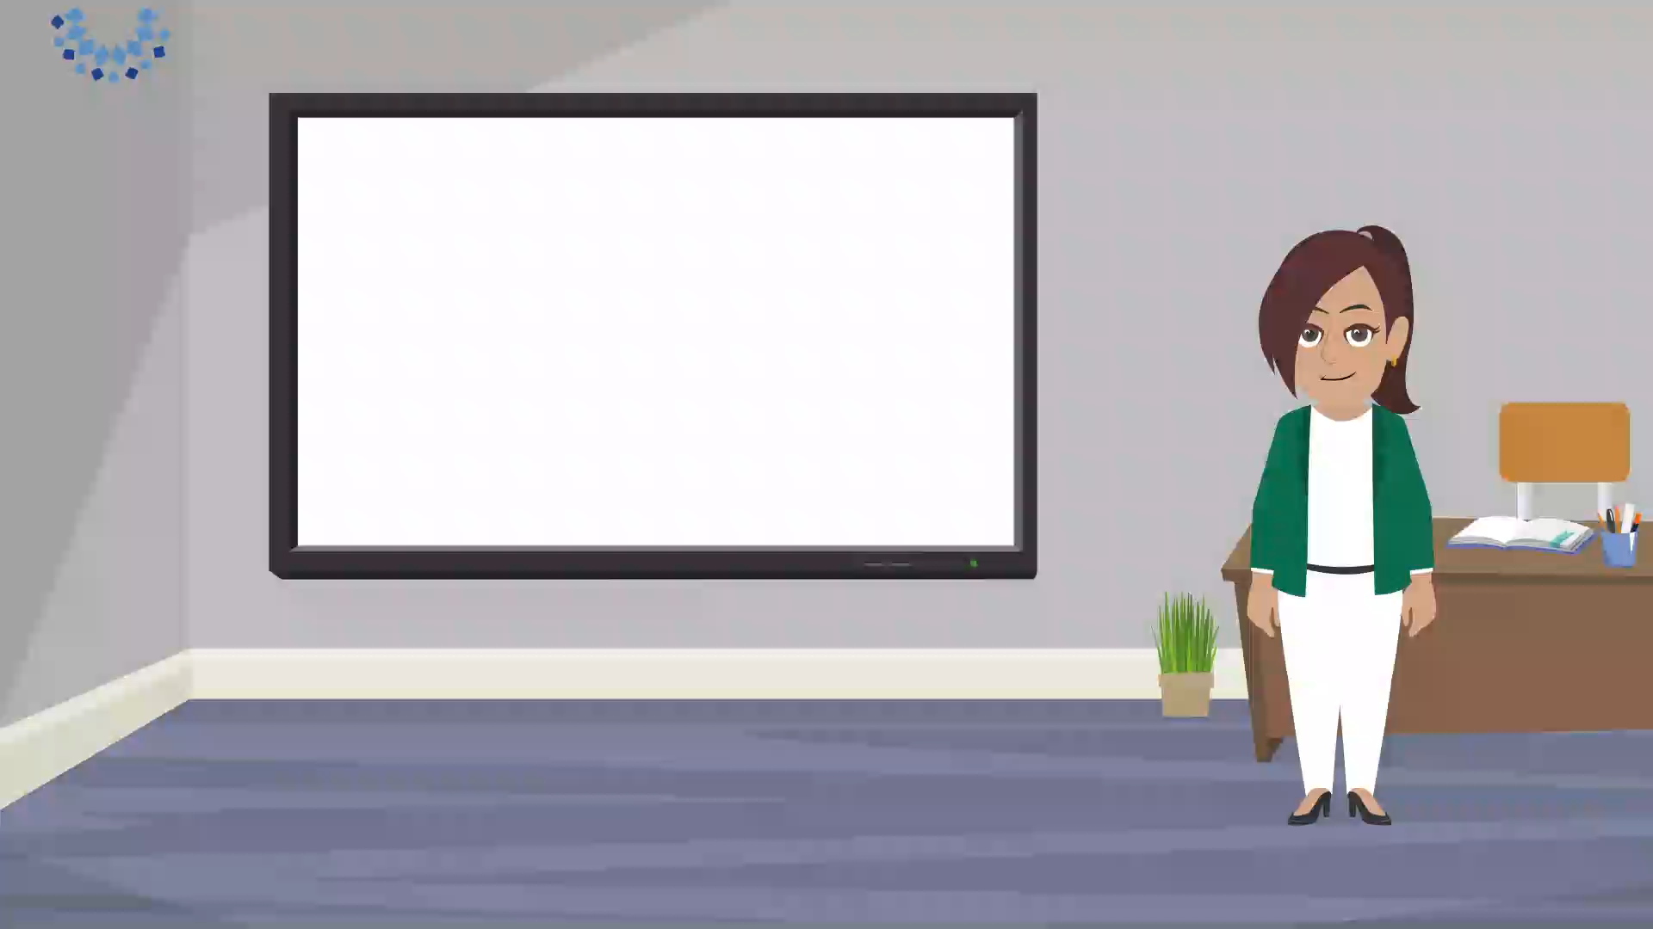
Learning Activity
  Learning Activity
Notes:
Teacher says:
Hello again.
In the previous session, you recognized 2 adjacent angles and checked whether 2 angles are adjacent or not.
Today, in our session, you will recognize another relation between 2 angles.
Look at the angles formed by these 2 intersecting straight lines.
They all have the same vertex O.
How are angles $\hat{A}$ and $\hat{B}$?
Adjacent: having same vertex, a common side and lie on either part of their common side.
$\hat{A}$ and $\hat{D}$? Also, adjacent angles
$\hat{A}$ and $\hat{C}$? They have the same vertex but don’t have a common side.
How are their sides? They are the prolongation of one another.
Angles $\hat{A}$ and $\hat{C}$ are called vertically opposite angles.
They have same vertex, and their sides are the prolongation of one another.
What about angles $\hat{B}$ and $\hat{D}$ ? They are also vertically opposite angles.
They have same vertex, and their sides are the prolongation of one another.
For the teacher:
Any 2 intersecting straight lines form 2 pairs of vertically opposite angles.
Any angle of the pair of the vertically opposite angles has the same adjacent angles as the other

Slide 5
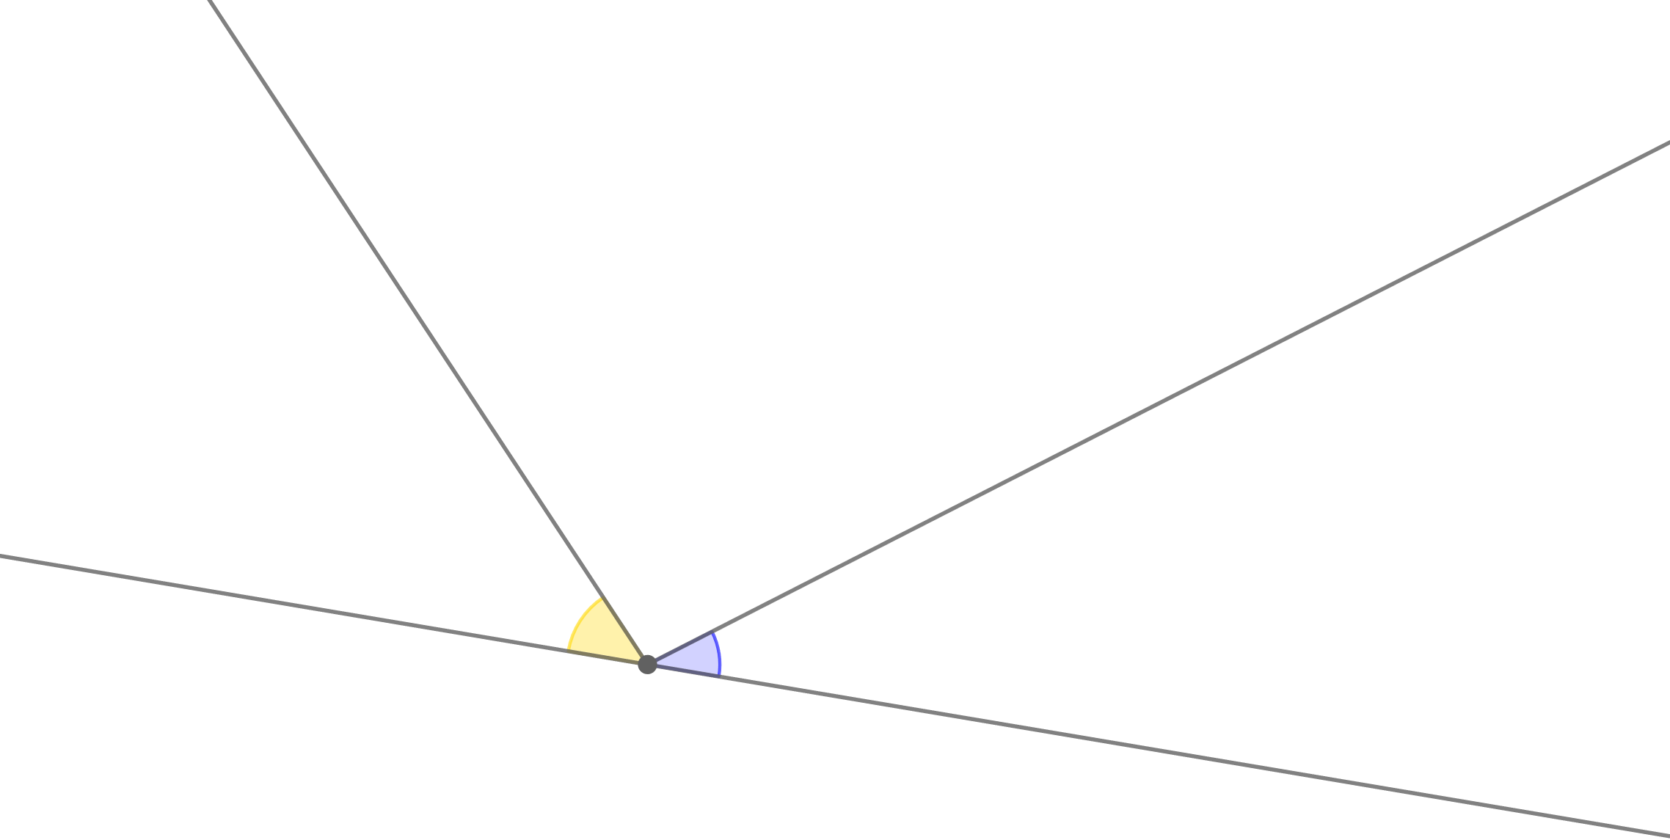
  Learning Activity
a
b
M
Notes:
Teacher says:
Are angles $a$and $b$vertically opposite?
Angles $a$and $b$have the same vertex M and one of the sides of angle $a$ is the prolongation of a side of angle $b$ but the other isn’t.
So, angles $a$and $b$aren’t vertically opposite.

Slide 6
  Result
Two angles are vertically
opposite when:
u
y
- they have the same vertex
A
- their sides are the prolongation of one another.
x
v
Notes:
Teacher says:
Now we can say that two angles are vertically opposite if they have same vertex, and their sides are the prolongation of one another.
Angles $\hat{xAv}$ and $\hat{yAu}$ are vertically opposite angles.
And angles $\hat{xAu}$ and $\hat{vAy}$ are vertically opposite angles.
.
Each pair have the same vertex A,
And their sides are the prolongation of one another.

Slide 7
Mastery of math facts
and fluency

Slide 8
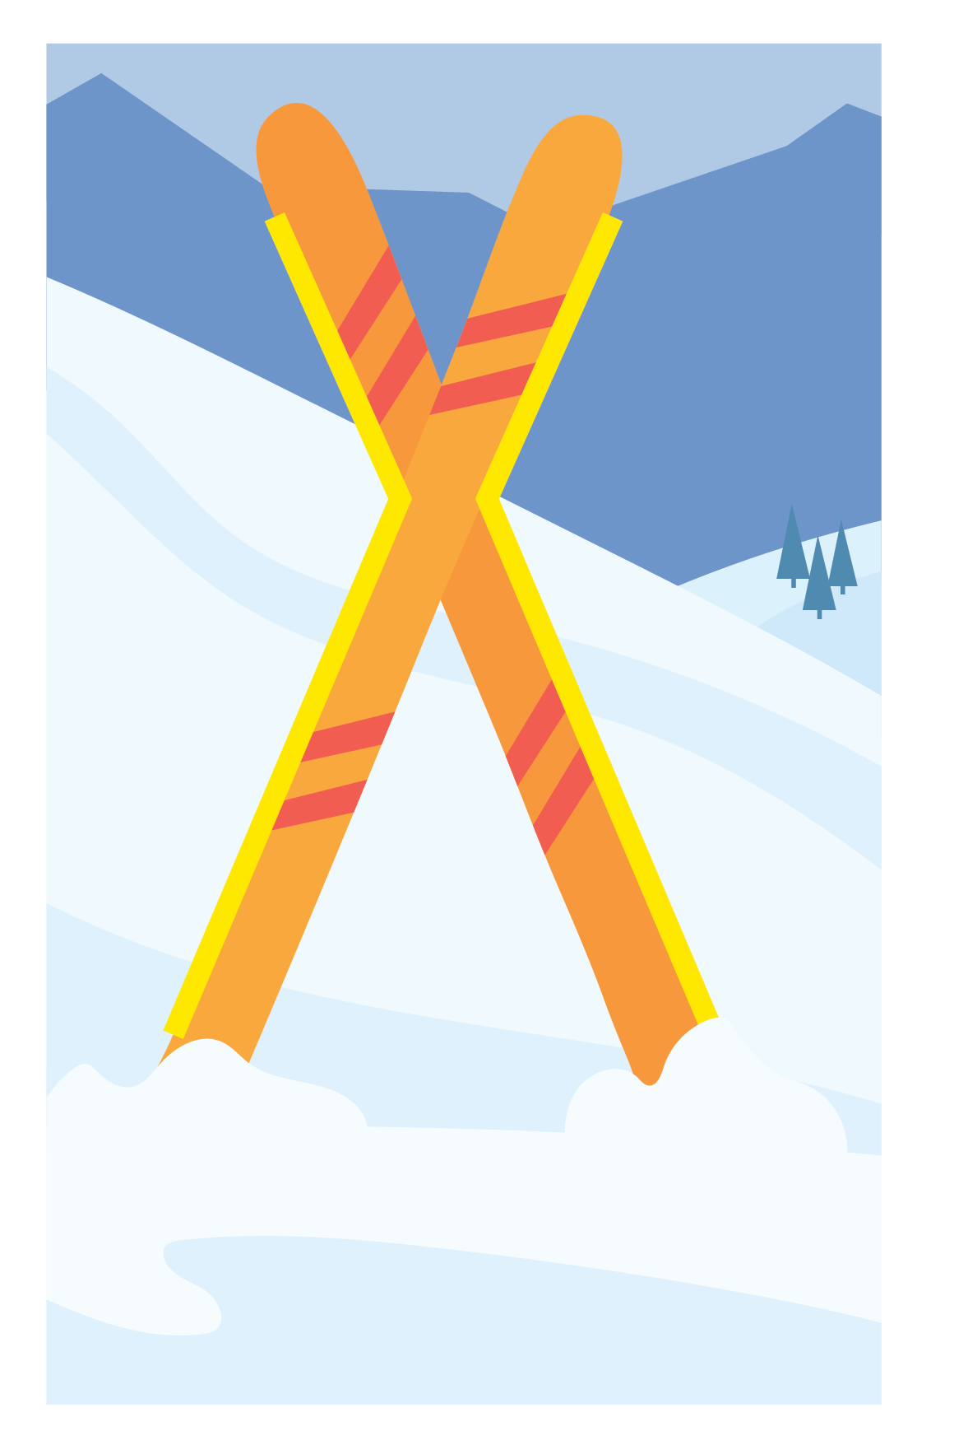
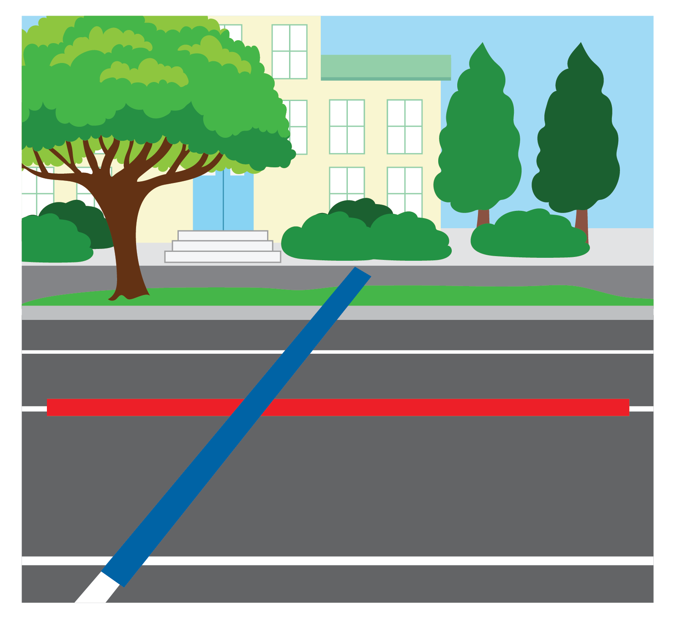
Applications
  Vertically Opposite Angles
Notes:
Teacher says
Before doing the applications ask students to give you real life examples of vertically opposite angles, they can see around them.
If there isn’t, some examples can be given

Slide 9
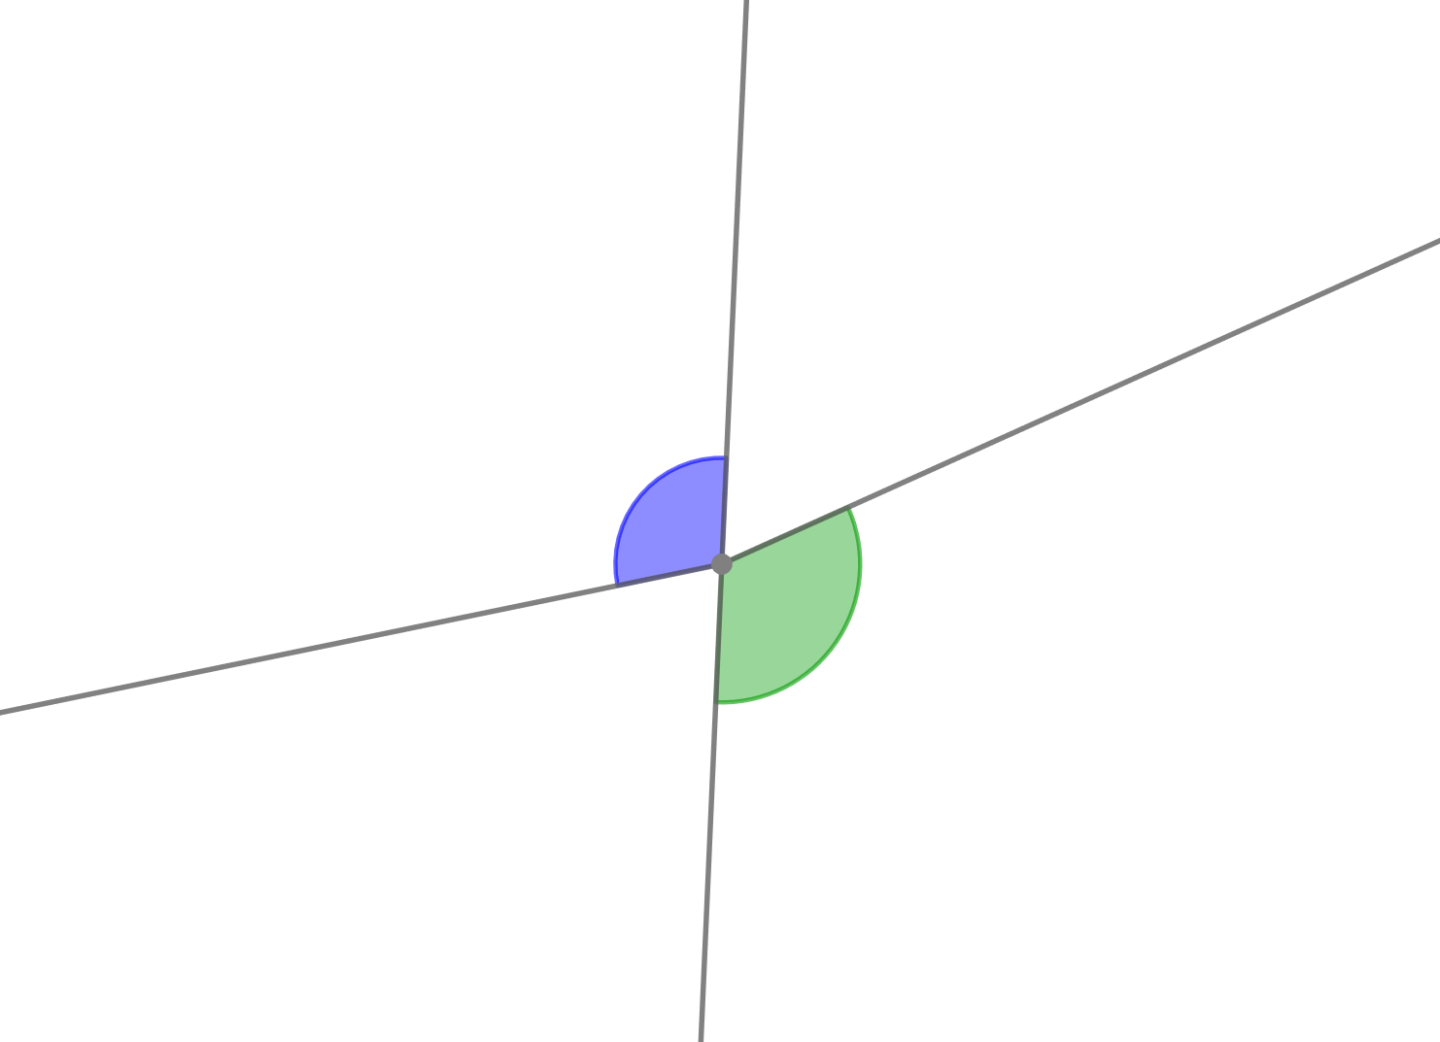
  Choose the correct answer
Are the two marked angles vertically opposite?
a
Yes
b
No
Notes:
Teacher says
Are the two marked angles vertically opposite?
Choose the correct answer.
For the teacher:
Ask students to justify their answers
Teacher says
They are not vertically opposite. They have the same vertex but one of the sides of angle A isn’t the prolongation of a side of angle B

Slide 10
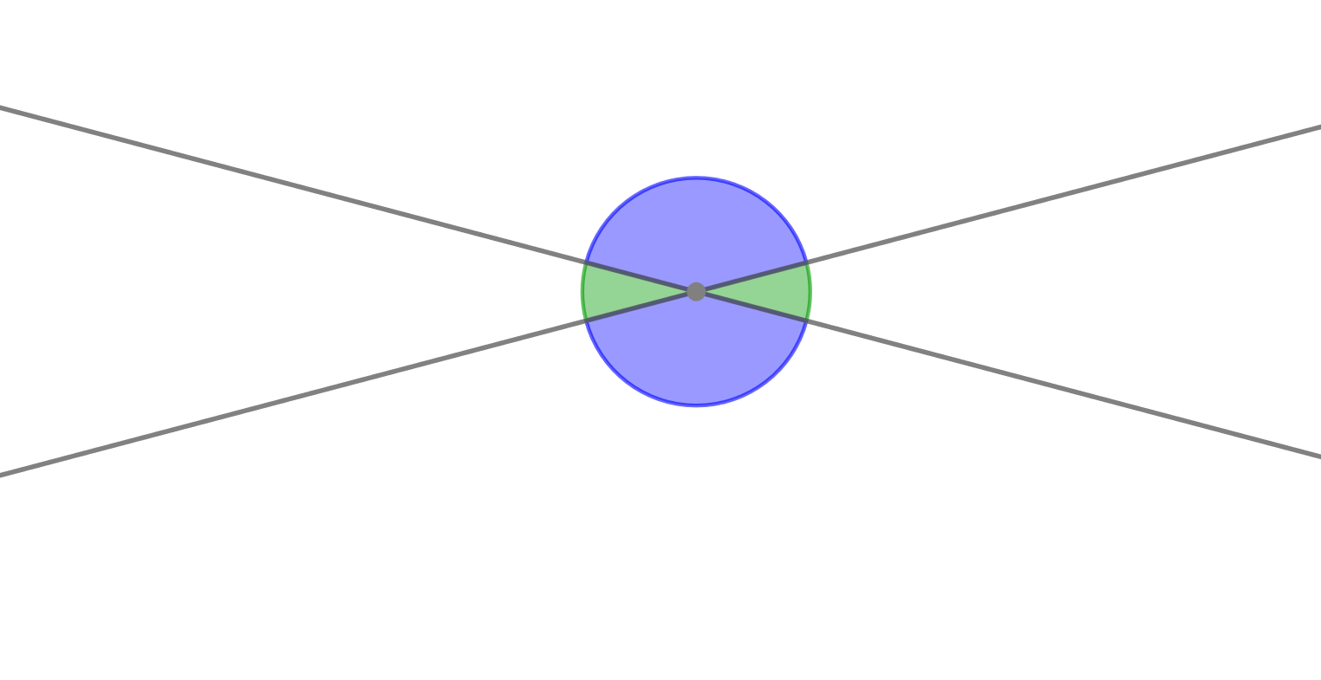
  Choose the correct answer
Are the two marked angles vertically opposite?
a
Yes
b
No
Notes:
Teacher says
They are vertically opposite. They have the same vertex, and their sides are the prolongation of one another

Slide 11
  Choose the correct answer
Are the two marked angles vertically opposite?
Yes
a
b
No
Notes:
Teacher says
They are not vertically opposite. One of the sides of angle A is not the prolongation of a side of angle B, they are adjacent angles.

Slide 12
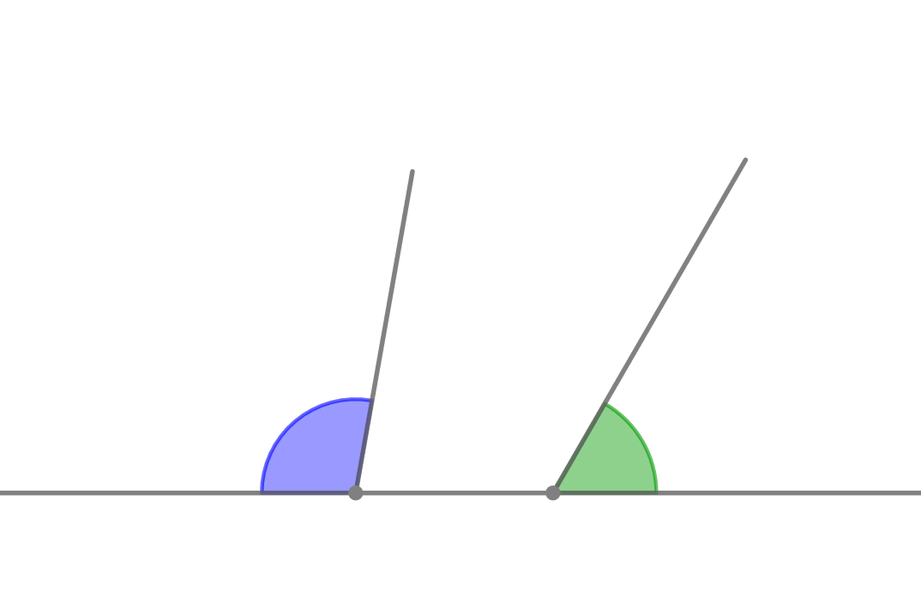
  Choose the correct answer
Are the two marked angles vertically opposite?
Yes
a
b
No
Notes:
Teacher says
They are not vertically opposite angles. They do not have the same vertex.

Slide 13
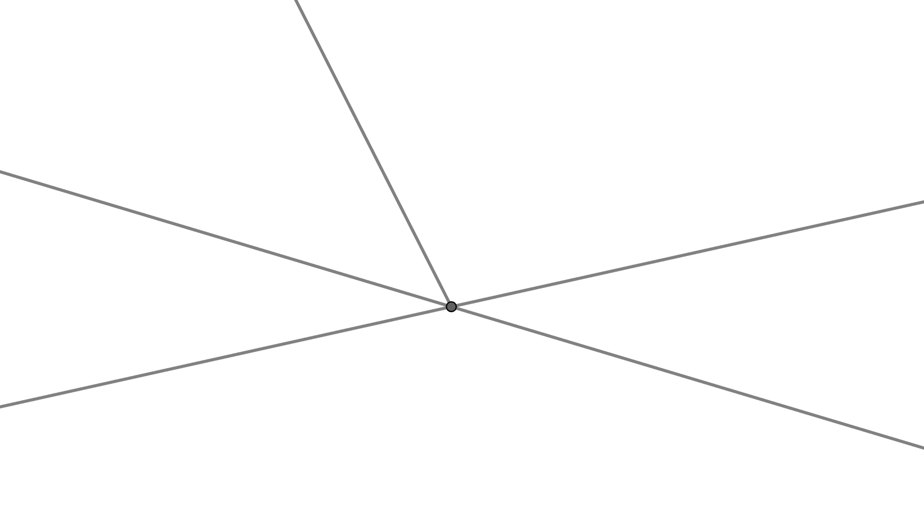


  Complete
$\hat{yOn}$
$\hat{………}$
$\hat{mOd}$ and are vertically opposite angles.
c
d
y
O
m
n
Notes:
Teacher says
Let’s do another application.
Use the figure and complete
For the teacher:
Ask students to justify their answers. You can complete with a wrong answer and ask them why they aren’t vertically opposite.
Teacher says
$\hat{mOd}$ and $\hat{yOn}$ are vertically opposite angles.
They have the same vertex, and their sides are the prolongation of one another

Slide 14


  Complete
$\hat{………}$
$\hat{yOd}$
$\hat{mOn}$ and are vertically opposite angles.
c
d
y
O
m
n
Notes:
Teacher says
$\hat{mOn}$ and $\hat{yOd}$ are vertically opposite angles.
They have the same vertex, and their sides are the prolongation of one another

Slide 15
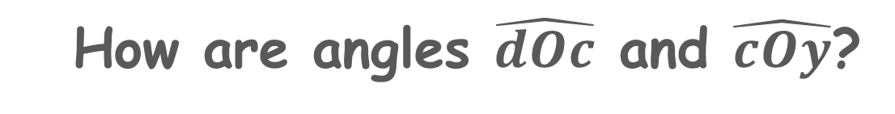
  Choose the correct answer
How are angles $\hat{dOc}$ and $\hat{cOy}$?
c
adjacent
y
d
vertically opposite
O
m
n
Notes:
Teacher says
Angles $\hat{dOc}$ and $\hat{cOy}$are adjacent angles.
They have the same vertex O, a common side [Oc) and they lie on either part of their common side.

Slide 16
  Choose the correct answer
Are angles $\hat{dOc}$ and $\hat{yOn}$vertically opposite?
c
Yes
y
d
No
O
m
n
Notes:
Teacher says
Angles $\hat{dOc}$ and $\hat{yOn}$are not vertically opposite angles
They have the same vertex O but one of the sides of angle $\hat{dOc}$ isn’t the prolongation of a side of angle $\hat{yOn}$

Slide 17


  Choose the correct answer
Which angle is vertically opposite to $\hat{yOn}$?
c
y
d
$\hat{………}$
$\hat{mOd}$
O
m
n
Notes:
Teacher says
Angle $\hat{mOd}$ is vertically opposite to angle $\hat{yOn}.$
They have the same vertex, and their sides are the prolongation of one another

Slide 18
Common formative assessment
Notes:
For the teacher:
Just for you to know that it is a formative assessment, the student only sees: check your understanding.

Slide 19
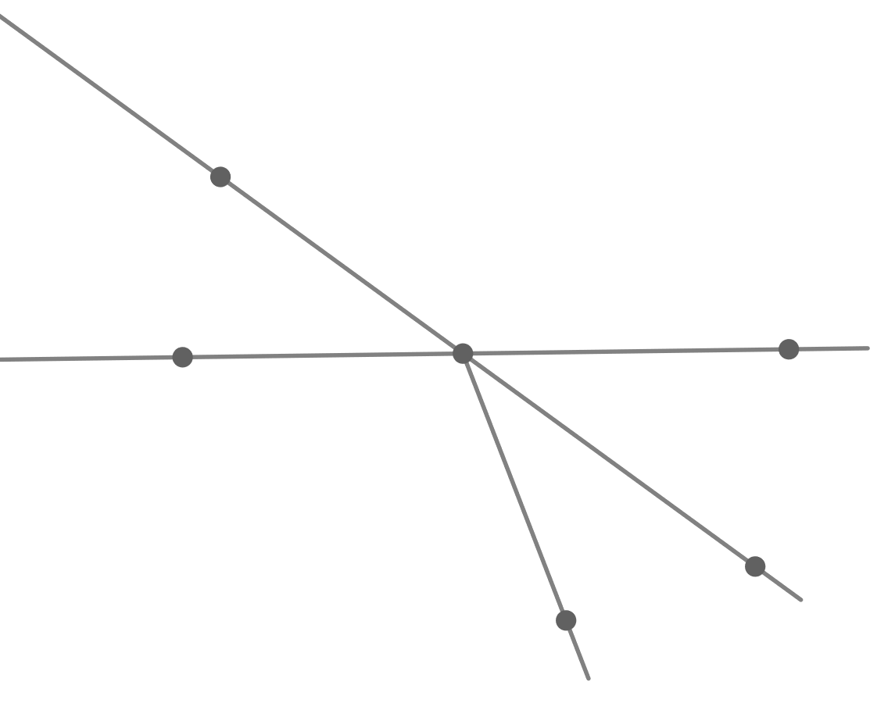
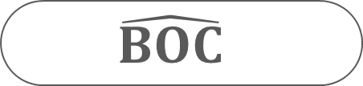
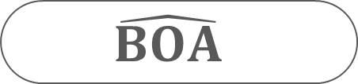
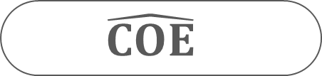
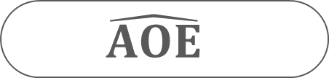
Check you understanding
  Choose the correct answer
Which of the following angles is adjacent to angle $\hat{COD}$?
A
$$\hat{BOA}$$
O
E
$$\hat{COE}$$
B
$$\hat{AOE}$$
D
C
$$\hat{BOC}$$
Notes:
Teacher says
Adjacent angles have the same vertex, a common side and they lie on either part of their common side.
Angles $\hat{COD}$ and $\hat{BOC}$ have the same vertex O, a common side [OC)
and they lie on either part of their common side, so they are adjacent angles.

Slide 20
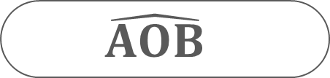
  Choose the correct answer
Which angle is vertically opposite to angle $\hat{EOD}$?
$$\hat{AOB}$$
A
$$\hat{COE}$$
O
E
B
$$\hat{AOE}$$
D
$$\hat{BOC}$$
C
Notes:
Teacher says
Vertically opposite angles have the same vertex, and their sides are the prolongation of one another.
Angles $\hat{EOD}$ and $\hat{AOB}$ have the same vertex O, and their sides are the prolongation of one another, so they are vertically opposite angles.

Slide 21
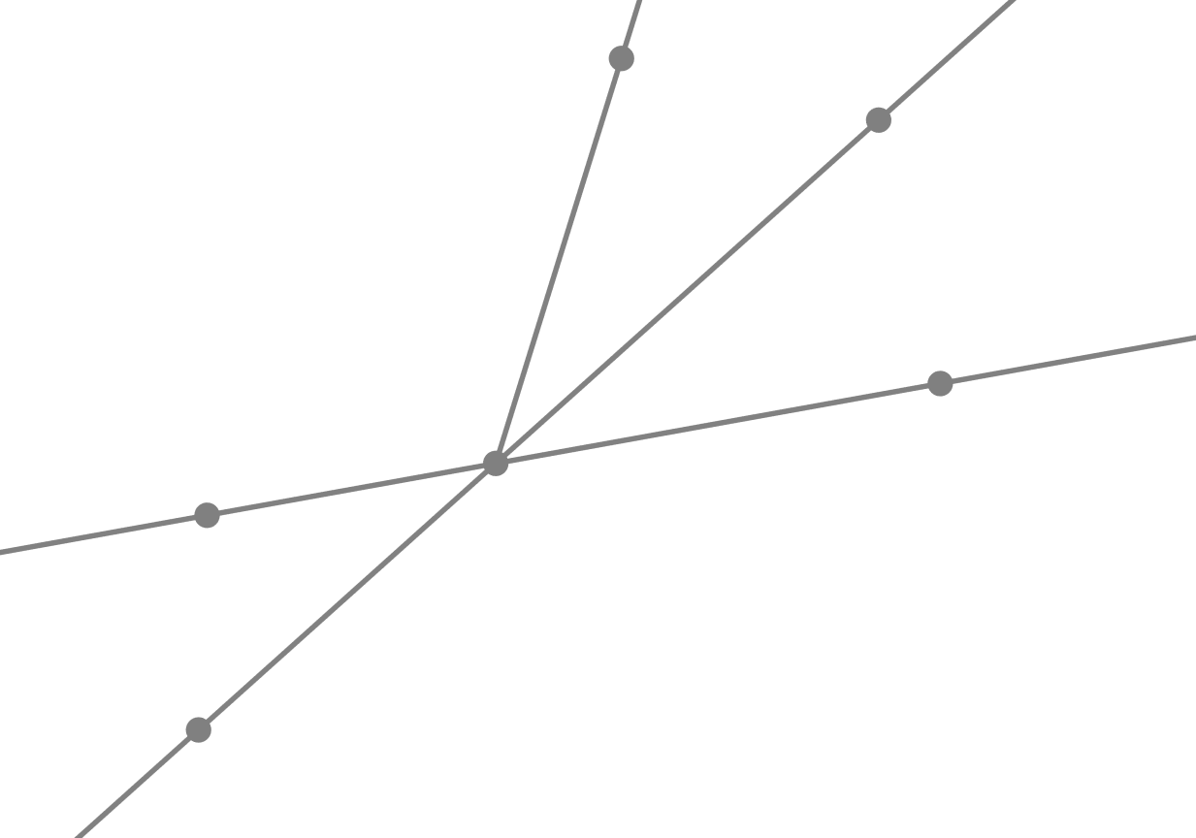

  Choose the correct answer
Angles $\hat{EAB}$ and $\hat{BAN}$ are adjacent angles.
What is their common side?
E
[AB)
B
[AE)
F
N
A
[AN)
[AM)
M
Notes:
Teacher says
Angles $\hat{EAB}$ and $\hat{BAN}$ are adjacent angles and their common side is [AB) for they lie on either part of [AB).

Slide 22
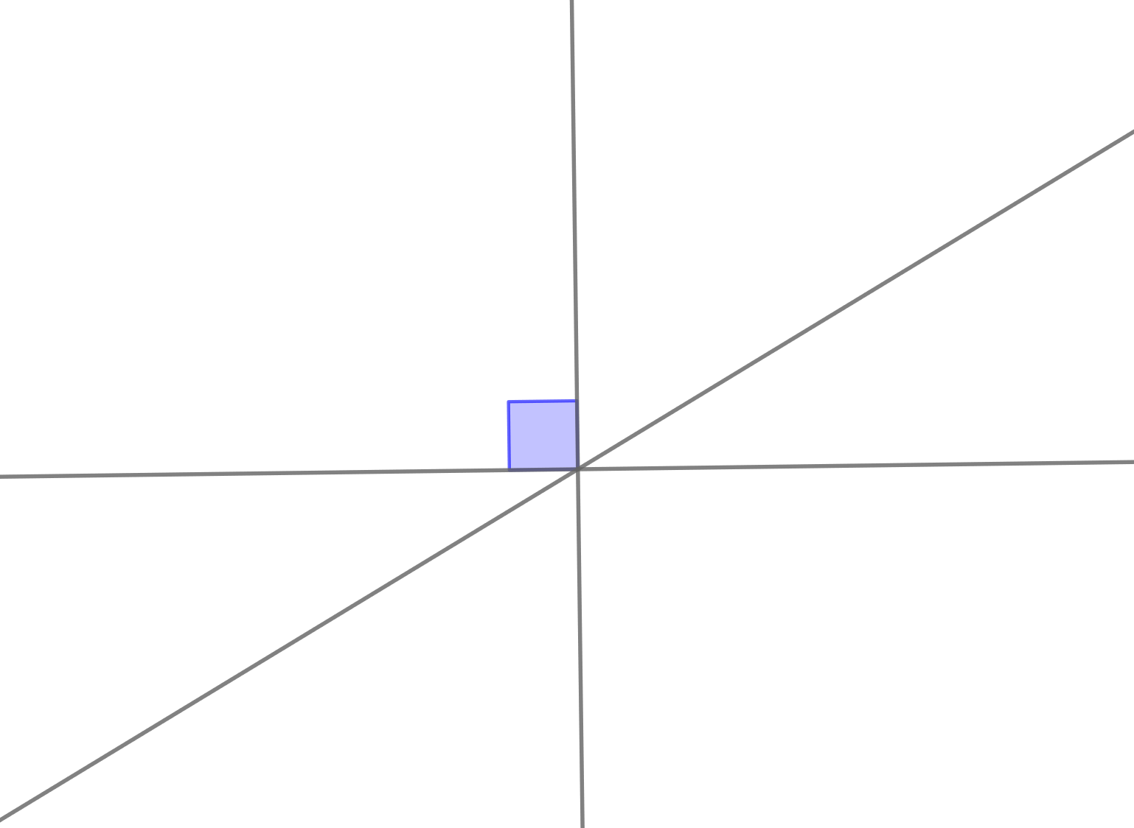
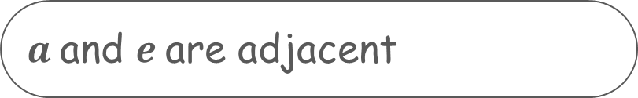
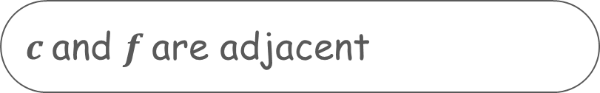



  Which statement is correct about these pairs of angles?
$a$and $c$are adjacent
b
c
a
$a$and $d$are vertically opposite
d
d
f
$c$and $f$are adjacent
$$e$$
$a$and $e$are adjacent
Notes:
Teacher says
$a$and $c$are not adjacent angles, they have the same vertex, but they don’t have a common side.
$a$and $d$are vertically opposite angles, they have the same vertex, and their sides are the prolongation of one another
b and f are not adjacent angles, they have the same vertex, but they don’t have a common side.
a and e are not vertically opposite angles, they have the same vertex but a side of one angle isn’t the prolongation of a side of the other angle.

Slide 23
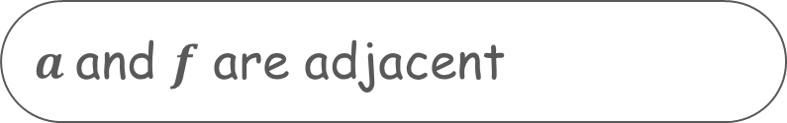

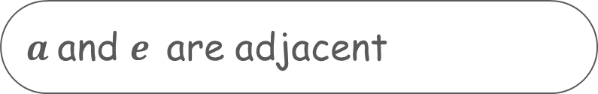

  Which statement is correct about these pairs of angles?
$a$and $e$ are adjacent
b
c
a
$a$and c are vertically opposite
a
d
f
f
$a$and $f$ are adjacent
e
$a$and $e$are vertically opposite
Notes:
Teacher says
$a$and $e$are not adjacent angles, they don’t have a common side.
$a$and $c$are not vertically opposite angles, they have the same vertex but a side of one angle isn’t the prolongation of a side of the other angle
$a$ and $f$are adjacent angles, they have the same vertex, a common side and they lie on either part of their common side.
$a$ and $e$are not vertically opposite angles, they have the same vertex but a side of one angle isn’t the prolongation of a side of the other angle

Slide 24
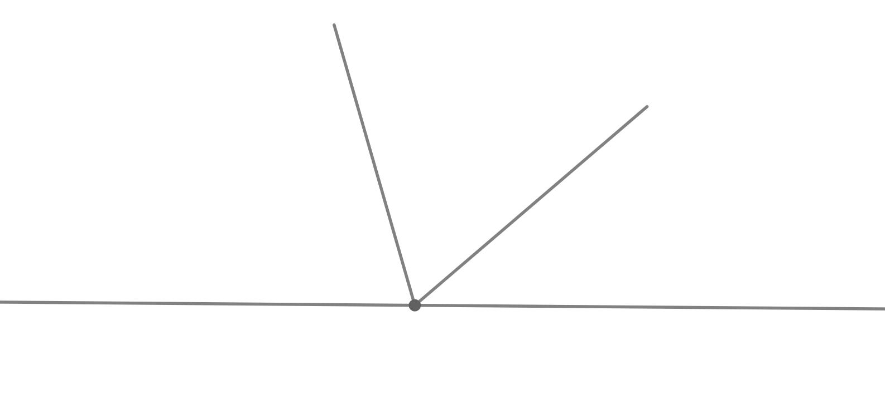



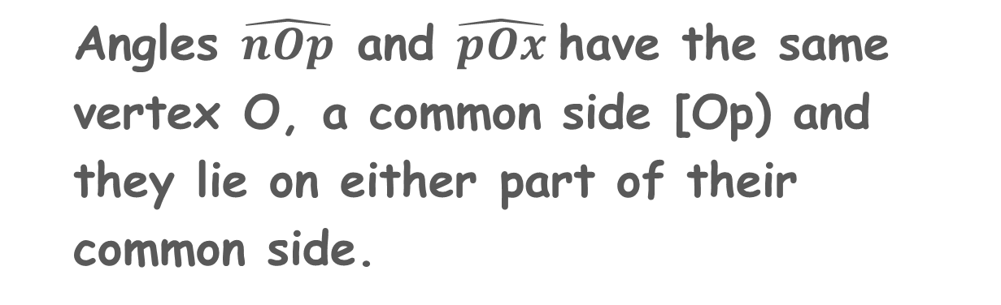

  Which of the following pairs of angles are adjacent?
p
n
$\hat{mOn}$ and $\hat{mOp}$
$\hat{nOp}$ and $\hat{pOx}$
x
O
m
$\hat{mOp}$ and $\hat{nOx}$
Angles $\hat{nOp}$ and $\hat{pOx}$have the same vertex O, a common side [Op) and they lie on either part of their common side.
$\hat{mOn}$ and $\hat{pOx}$
Notes:
Teacher says
Adjacent angles have the same vertex, a common side and they lie on either part of their common side.
Angles $\hat{nOp}$ and $\hat{pOx}$ have the same vertex O, a common side [Op) and they lie on either part of their common side.

Slide 25


