Slide 1

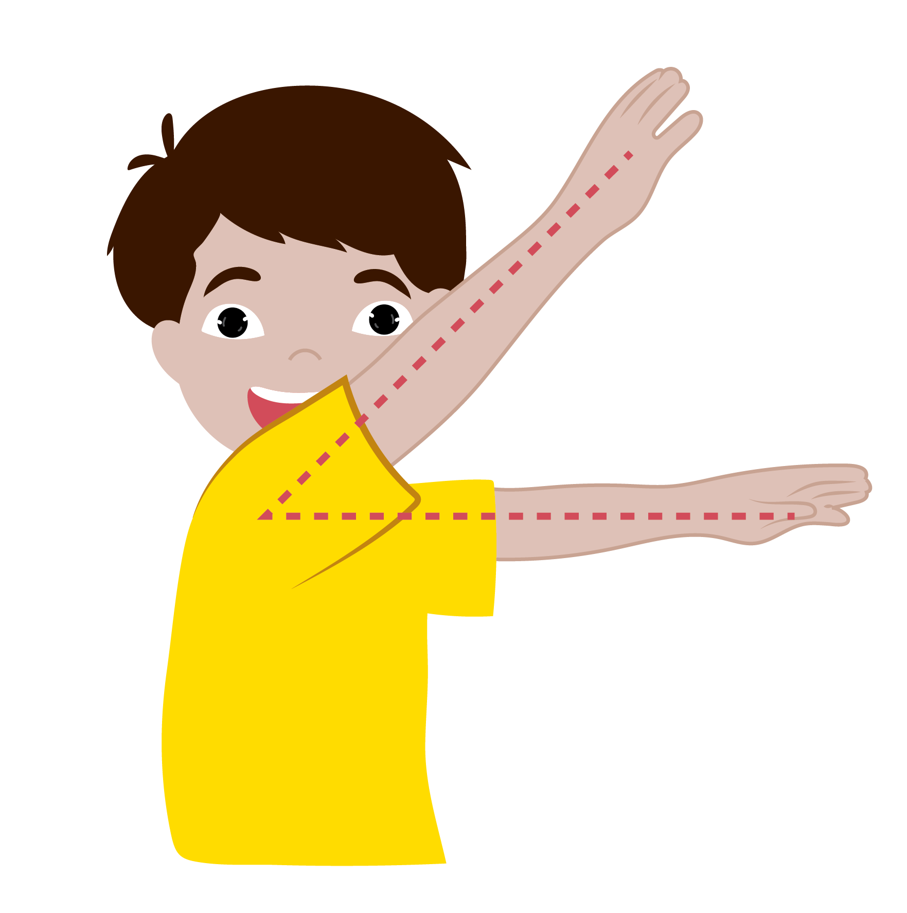

  Bisector of an Angle
      Grade 6- Chapter 9
This material is made possible with the support of the American people through the United States Agency for International Development (USAID). The content is the sole responsibility of QITABI 2 and does not necessarily reflect the views of USAID or the United States Government. This material was developed by the Joint Academic Department (JAD) and the Equipment Installations and Material Support Bureau (EIMSB) at the Centre of
Educational Research and Development (CERD) with the support of USAID-funded QITABI 2 project.

Slide 2

  Specific Learning Objective 2
At the end of this session, you will be able to construct the bisector of an angle with a protractor.
Notes:
Notes for the teacher
At the end of this session, you will be able to construct the bisector of an angle with a protractor.

Slide 3

Understanding
Conceptual Understanding

Slide 4
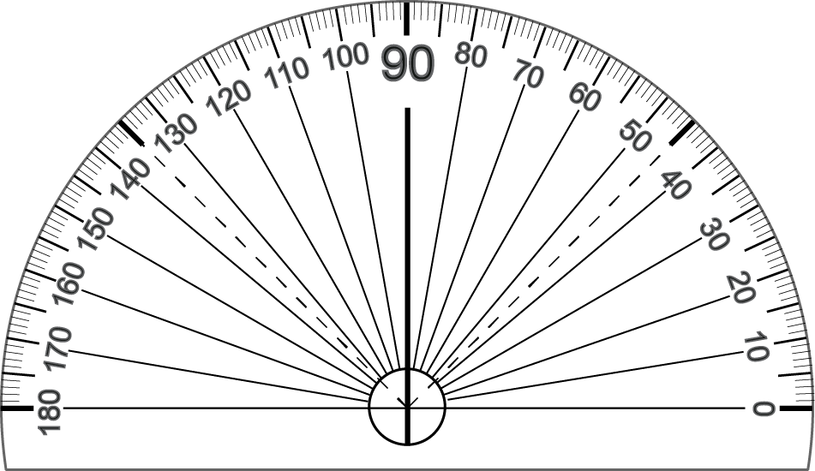

Learning Activity
  Constructing the bisector of an angle
$$\hat{mOn}=80°$$
[Oz) bisector of $\hat{mOn}$
$\hat{mOz}$and $\hat{nOz}$are 2
equal adjacent angles.
n
z
Z
40º
40º
O
m
Notes:
Teacher says:
Hello again.
In the previous session you recognized the bisector of an angle and noticed that it divides the angle into two equal adjacent angles.
Today you will learn how to construct the bisector using a protractor.
Ready? Let’s start.
Given angle $\hat{mOn}$ of measure 80º
Let’s construct [Oz) the bisector of angle $\hat{mOn}$
The bisector of an angle can be constructed with a protractor.
To draw the bisector of angle $\hat{mOn}$ using the protractor, we divide the measure of angle $\hat{mOn}$ by 2, for the bisector of an angle divides it into 2 equal adjacent angles.
80º divided by 2 is 40º
We use the protractor to draw semi straight line [Oz) such that $\hat{mOz}$is 40º
Now, measure angle $\hat{zOn}$
The measure of each of the 2 adjacent angles $\hat{mOz} and \hat{zOn}$is 40º
$\hat{mOz}$and $\hat{nOz}$are 2 equal adjacent angles.
For the teacher:
Start the session by asking students to draw some angles with specific measures (using the protractor)

Slide 5

  Bisector of an angle
u
y
$$\hat{xOy}=55°$$
[Oy) bisector of $\hat{xOu}$
$\hat{xOy} =$ $\hat{yOu}=55°$
$$\hat{xOu} =55° ×2 =110°$$
$$\hat{xOu} =\hat{xOy}+ \hat{yOu}=110°$$
55°
55°
O
x
Notes:
Teacher says:
Now look at this angle.
Given angle $\hat{xOy}$ of measure 55º
We need to draw angle $\hat{yOu}$ such that [Oy) is the bisector of angle $\hat{xOu}$
[Oy) is the bisector of angle $\hat{xOu}$, so it divides the angle into 2 equal adjacent angles.
So $\hat{xOy}=\hat{yOu}=55°$
Let’s use the protractor and draw an angle adjacent to $\hat{xOy}$and of measure 55º
What about finding the measure of angle $\hat{xOu}$ ?
$\hat{xOu}$is the double of $\hat{xOy} that is 55$º x 2 = 110º
Also, $\hat{xOu}=\hat{xOy}+\hat{yOu}=55°+55°=110°$

Slide 6
Mastery of math facts and fluency

Slide 7
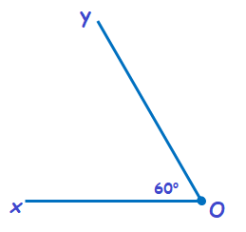
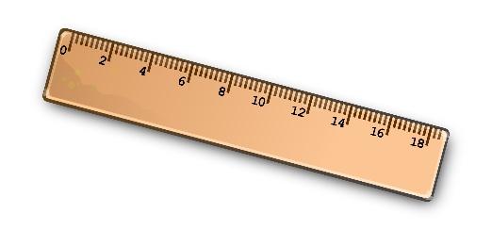
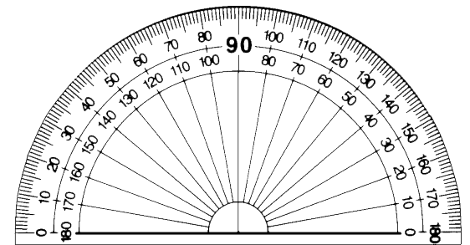

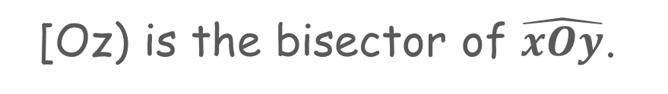
Applications
  Draw [Oz) using protractor, ruler, and pencil
[Oz) is the bisector of $\hat{xOy}$.
Notes:
Teacher says:
Use the instruments in the toolbox and complete the following drawing.
For the teacher:
Before doing the application, be sure that students understand the concept of the bisector of the angle : the semi straight line issued from the vertex and divides the angle into two equal adjacent angles

Slide 8
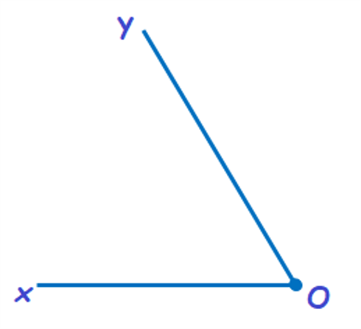
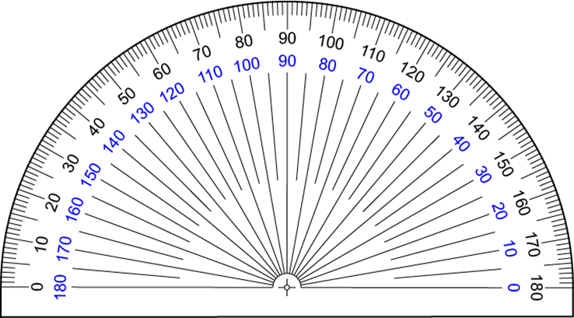
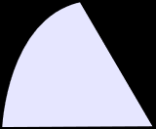
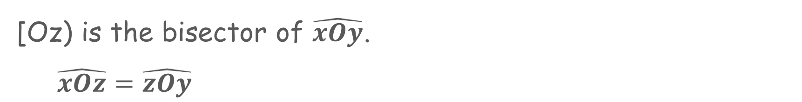
  Answer Key
[Oz) is the bisector of $\hat{xOy}$.
$\hat{xOz}=\hat{zOy}$
z
60°
Notes:
Teacher says:
[Oz) is the bisector of $\hat{xOy}$
Then [Oz) divides the angle into two equal adjacent angles $\hat{xOz }and\hat{ zOy}$

Slide 9
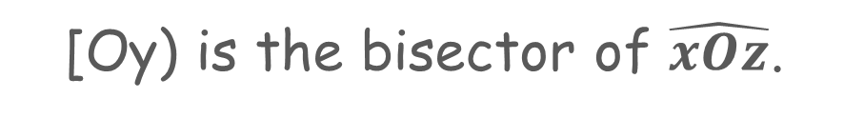
  Draw using protractor, ruler, and pencil
[Oy) is the bisector of $\hat{xOz}$.
Notes:
Teacher says:
Use the instruments in the toolbox and complete the following drawing.
For the teacher:
Before doing the application, be sure that students understand the concept of the bisector of the angle : the semi straight line issued from the vertex and divides the angle into two equal adjacent angles

Slide 10

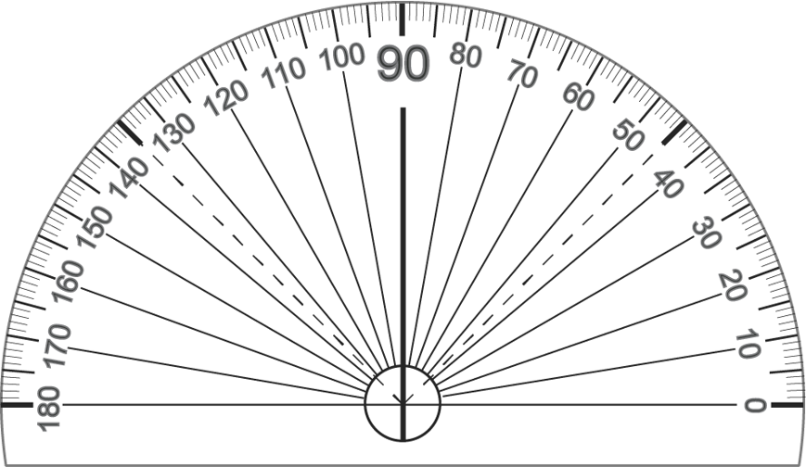

  Answer Key
[Oy) is the bisector of $\hat{xOz}$.
$\hat{xOy}=\hat{yOz}$
60°
Notes:
Teacher says:
[Oy) is the bisector of $\hat{xOz}$
Then [Oy) divides the angle into two equal adjacent angles $\hat{xOy }and\hat{ yOz}$

Slide 11

  Draw using protractor, ruler, and pencil
[Ox) is the bisector of $\hat{yOz}$.
[Oy) is the bisector of $\hat{xOz}$.
Notes:
Teacher says:
Use the instruments in the toolbox and complete the following drawing.
For the teacher:
Before doing the application, be sure that students understand the concept of the bisector of the angle : the semi straight line issued from the vertex and divides the angle into two equal adjacent angles

Slide 12
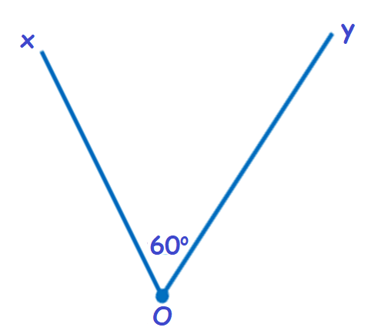
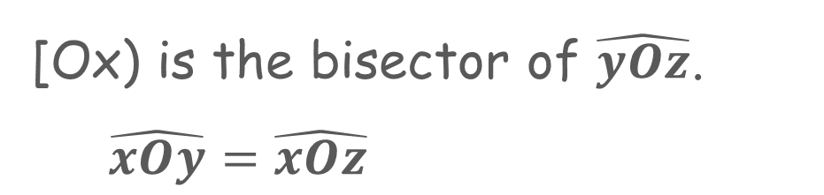
  Answer Key
[Ox) is the bisector of $\hat{yOz}$.
$\hat{xOy}=\hat{xOz}$
z
Notes:
Teacher says:
[Ox) is the bisector of $\hat{yOz}$
Then [Ox) divides the angle into two equal adjacent angles $\hat{xOy }and\hat{ xOz}$

Slide 13
Common formative assessment
Notes:
For the teacher:
Just for you to know that it is a formative assessment, the student only sees: check your understanding.

Slide 14
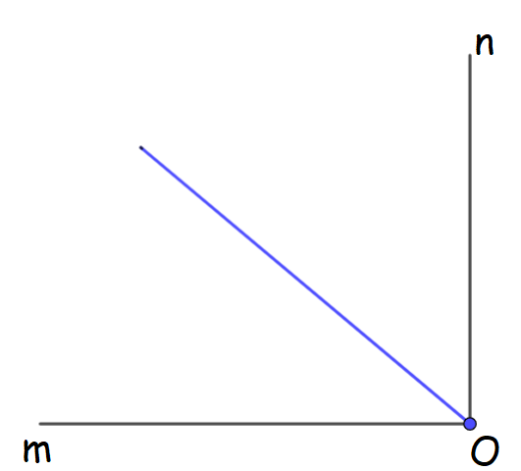
Check your understanding
  Select the correct answer
Is the protractor used correctly to draw the bisector of angle $\hat{mOn }?$
Yes
No
Notes:
Teacher says:
Select the correct answer.

Slide 15
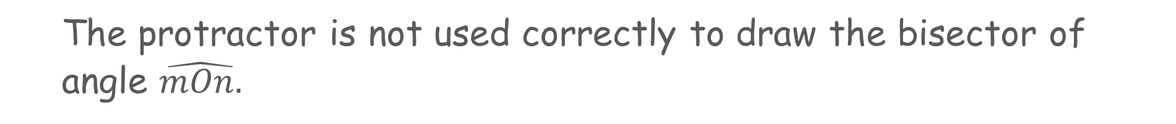
  Answer Key
The protractor is not used correctly to draw the bisector of angle $\hat{mOn.}$
Yes
No
Notes:
Teacher says:
No.
The bisector of an angle should divide it into two equal adjacent angles.
$\hat{mOn}$ = $90°$. The bisector should divide it into two equal angles each measures 45º

Slide 16
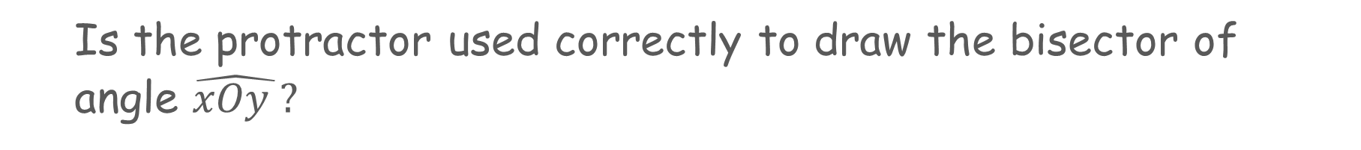
  Select the correct answer
Is the protractor used correctly to draw the bisector of angle $\hat{xOy }?$
y
Yes
No
x
O
Notes:
Teacher says:
Select the correct answer.

Slide 17
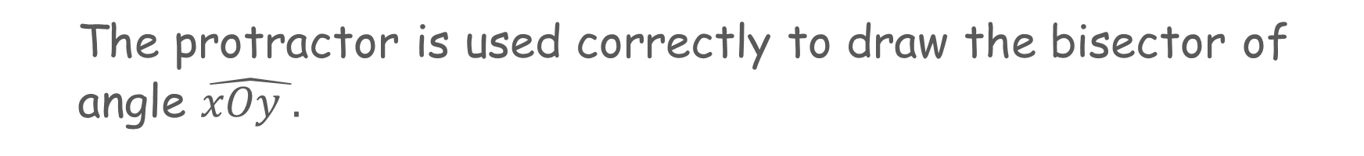
  Answer Key
The protractor is used correctly to draw the bisector of angle $\hat{xOy .}$
y
Yes
No
c
O
Notes:
Teacher says:
Yes.
The bisector of the angle drawn divides it into two equal adjacent angles.
$\hat{xOy}$ = 12$0°$. The bisector divides it into two equal adjacent angles each measures 60º

Slide 18
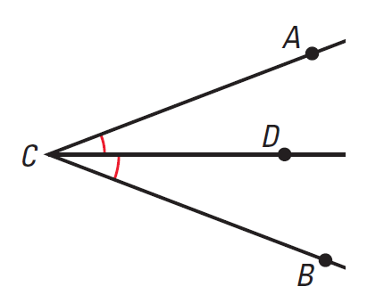





  Complete
$\hat{………}$
[CD) is the bisector of
$\hat{………}$
$\hat{BCD}$=
$\hat{………}$
$\hat{BCD}$= ÷ 2
Notes:
Teacher says:
Use the figure and complete by writing the name of the convenient angle.
For the teacher:
Ask students to justify their answers

Slide 19




  Answer Key
$\hat{………}$
$\hat{BCA}$
[CD) is the bisector of
$\hat{………}$
$\hat{BCD}$=
$\hat{DCA}$
$\hat{………}$
$\hat{BCA}$
$\hat{BCD}$= ÷ 2
Notes:
Teacher says:
[CD) is the bisector of angle $\hat{BCA}$, it divides the angle into two equal adjacent angles so
$\hat{BCD}$= $\hat{DCA}$
And $\hat{BCD}$= $\hat{BCA}$ ÷ 2

Slide 20

  Use the protractor and find the measure of $\hat{BCD}$
_____ º
$\hat{BCD}$=
Notes:
Teacher says:
Use the protractor and find the measure of angle $\hat{BCD}$

Slide 21

  Answer Key
20 °
_____ º
$\hat{BCD}$=
Notes:
Teacher says:
$Angle \hat{BCD}$ measures 20º

Slide 22
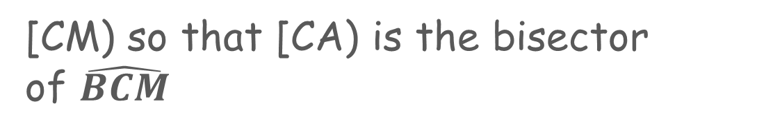
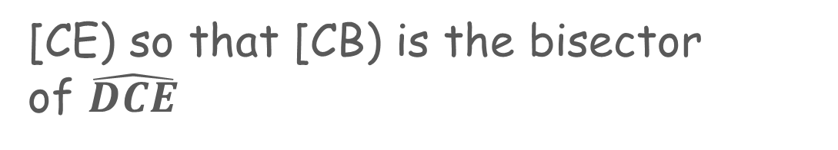
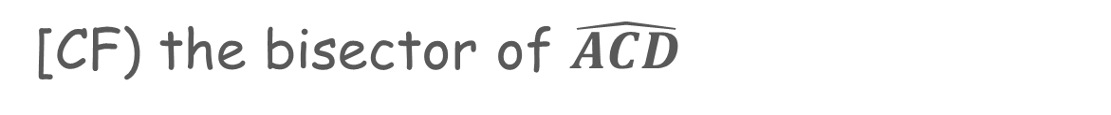
  Draw using protractor, ruler, and pencil
[CF) the bisector of $\hat{ACD}$
[CE) so that [CB) is the bisector
of $\hat{DCE}$
[CM) so that [CA) is the bisector
of $\hat{BCM}$
Notes:
Teacher says:
Now draw [CF) the bisector of $\hat{ACD}$
Draw [CE) so that [CB) is the bisector of $\hat{DCE}$
And draw [CM) so that [CA) is the bisector of $\hat{BCM}$

Slide 23
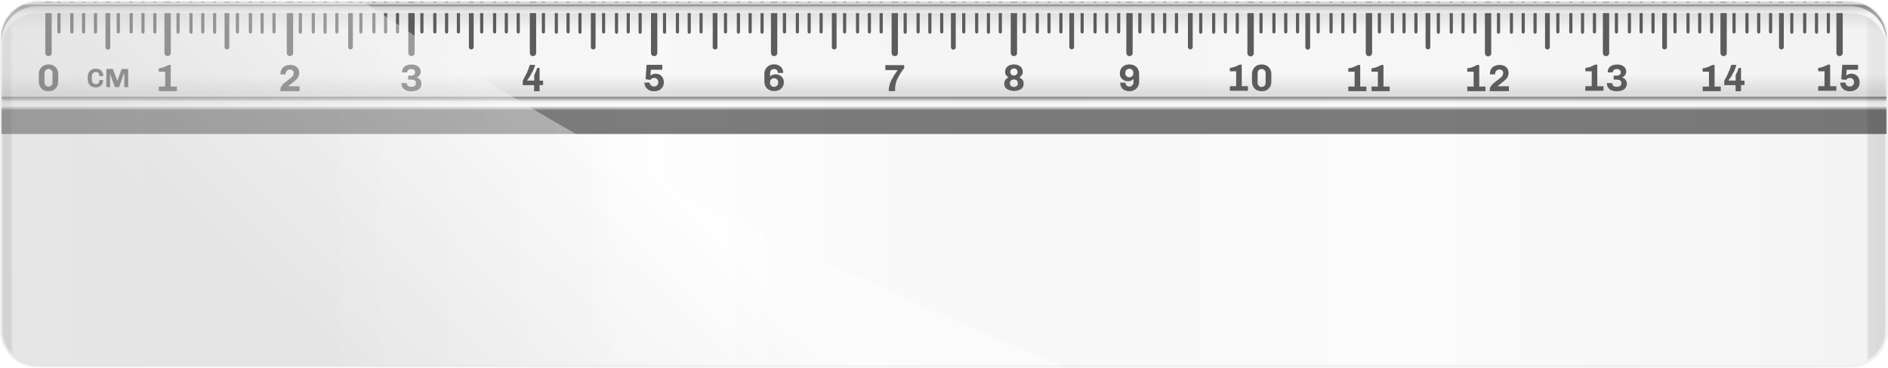
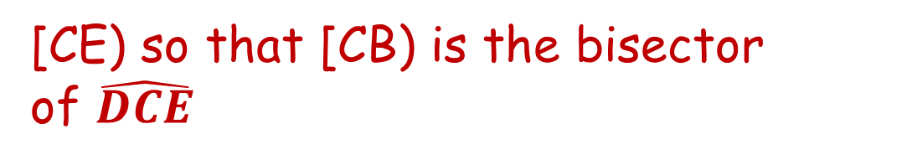

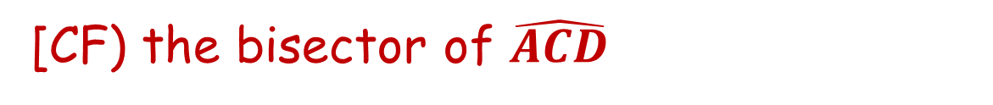

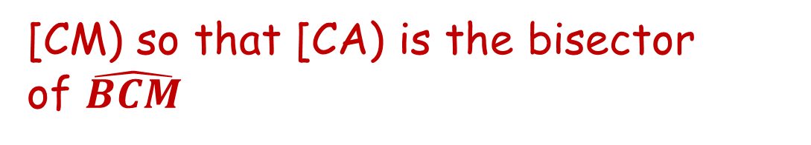
  Answer Key
M
[CF) the bisector of $\hat{ACD}$
[CF) the bisector of $\hat{ACD}$
F
[CE) so that [CB) is the bisector
of $\hat{DCE}$
[CE) so that [CB) is the bisector
of $\hat{DCE}$
[CM) so that [CA) is the bisector
of $\hat{BCM}$
[CM) so that [CA) is the bisector
of $\hat{BCM}$
E
Notes:
Teacher says:
[CF) is the bisector of angle $\hat{ACD}$ so $\hat{ACF}$= $\hat{FCD}$
[CB) is the bisector of $\hat{DCE}$ so $\hat{DCB}$= $\hat{BCE}$
And [CA) is the bisector of $\hat{BCM}$ so $\hat{BCA}$= $\hat{ACM}$

Slide 24


