Slide 1

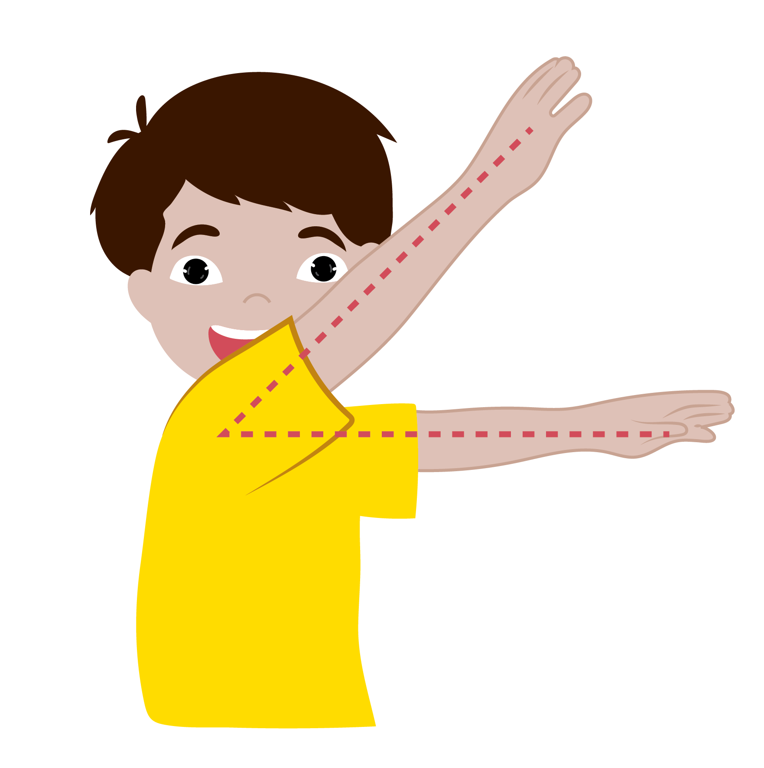

  Bisector of an Angle
      Grade 6- Chapter 9
This material is made possible with the support of the American people through the United States Agency for International Development (USAID). The content is the sole responsibility of QITABI 2 and does not necessarily reflect the views of USAID or the United States Government. This material was developed by the Joint Academic Department (JAD) and the Equipment Installations and Material Support Bureau (EIMSB) at the Centre of
Educational Research and Development (CERD) with the support of USAID-funded QITABI 2 project.

Slide 2
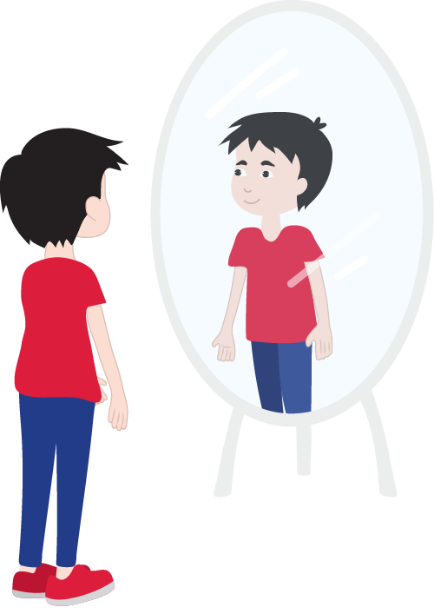
Social-Emotional Learning
  Emotions
Notes:
Teacher says:
Hello again.
It is the last session in this chapter.
Do you remember when we drew the faces of 5 different expressions in our first session?
Now, take a moment to identify how you feel at the start of this session.
To do this, stand in front of a mirror and look at your facial expressions of how you feel.
Now try this. If you express/feel a certain emotion, can you rate it on a scale of 1-10?
In other words, how deeply are you feeling this emotion? Is it strong? Or can you manage? Now can you give it a different name so that it really describes what you are feeling?
It is important to differentiate between these feelings and the intensity of those feelings/how strong those feelings are; this can help you manage them better and could even help you learn better.
Let’s get started with our session.
For the teacher:
For the teacher: An activity before starting the session, that helps students to be aware of their emotions.
Learning objectives: Differentiate between different emotions as they arise.
20

Slide 3
Specific Learning Objective 4
At the end of this session, you will be able to use the following property: the bisector of an angle divides it into two equal angles.
Notes:
Teacher says:
At the end of this session, you will be able to use the following property: the bisector of an angle divides it into two equal angles.

Slide 4

Understanding
Conceptual Understanding

Slide 5

Learning Activity
  Bisector of an angle
Notes:
Teacher says:
In the previous session you learned to construct the bisector of an angle using a protractor and a compass as well.
You noticed that the bisector divides the angle into two equal parts.
But can we use this as a property any time?
Let’s see.
Given $\hat{xOy}=100°$
[Ou) is the bisector of $\hat{xOy}$
Use the protractor and find the measure of each of the angles $\hat{xOu}$ and $\hat{yOu}$ .
What do you notice?
The bisector of an angle divides it into 2 equal adjacent angles
so $\hat{xOu}=\hat{yOu}=\hat{xOy}÷2=100°÷2=50°$
For the teacher:
Students know how to construct the bisector of an angle and that it divides the angle into 2 equal parts, so they have to use such a property. It is useful to be used in justifying answers.

Slide 6
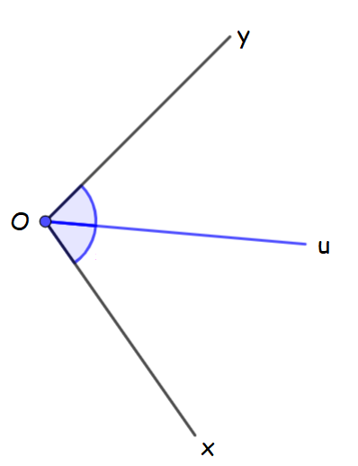

  Bisector of an angle
$$\hat{xOu}=\hat{yOu}$$
[Ou) is the bisector of $\hat{xOy}$
Notes:
Teacher says:
Given $\hat{xOu}=\hat{yOu}$
What does [Ou) represent for angle $\hat{xOy}$?
[Ou) is the bisector of $\hat{xOy}$
For if a semi straight line divides an angle into 2 equal adjacent angles, then it is its bisector.

Slide 7
Mastery of math facts
and fluency

Slide 8
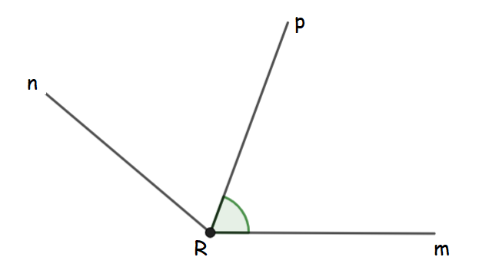


Applications
  Find the measure of the following angles
$\hat{mRp}=70°,$and [Rp) is the bisector of angle $\hat{mRn}$
_____ º
$\hat{pRn}=$
70º
_____ º
$\hat{mRn}=$
Notes:
Teacher says:
Let’s do some applications.
Given [Rp) is the bisector of $\hat{mRn}$ and $\hat{mRp}=70°$
Find the measure of each of the angles $\hat{pRn}$ and $\hat{mRn}$ .
For the teacher:
Give examples without figures and ask students to draw a sketch to find the measure of angles (the whole angle or a part of it after being divided by a bisector) to be sure that they understand the concept and not find answers by measuring only.
Ask students to show their work

Slide 9

  Find the measure of the following angles
[Rp) is the bisector of angle $\hat{mRn},$then $\hat{mRp}=\hat{pRn}=70°$
70°
$\hat{pRn}=$
70º
140°
$\hat{mRn}=$
$\hat{mRn}$ = $\hat{\hat{mRp}×2=70°×2=140°}$
Notes:
Teacher says:
[Rp) is the bisector of $\hat{mRn}$ then $\hat{mRp}=\hat{pRn}= 70°$
For the bisector of an angle divides it into two equal angles
$\hat{mRn}$ is the double of $\hat{mRp}$ or the sum of $\hat{mRp} and \hat{pRn}$
$m\hat{R}n$= $m\hat{R}p ×2=70°×2=140°$

Slide 10
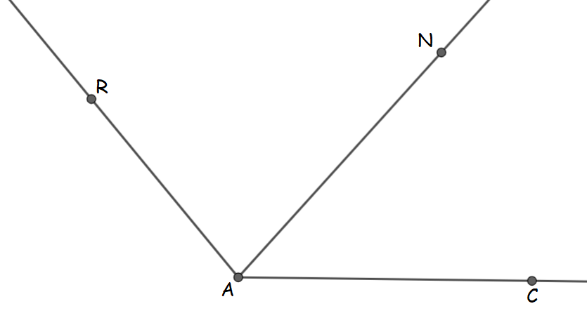

  Complete
$\hat{ CAR}=130°$ and $\hat{CAN}=65°$
_____ º
$\hat{RAN}=$
_____
[AN) is the of angle $\hat{CAR}$
Notes:
Teacher says:
Let’s do another application.
Use the figure and answer the questions
Given : $\hat{CAR}=130°$ and $\hat{CAN}= 65°$
Find the measure of angle $\hat{RAN}$
What does [AN) represent for angle $\hat{CAR}$ ?
For the teacher:
Ask students to justify their answers

Slide 11
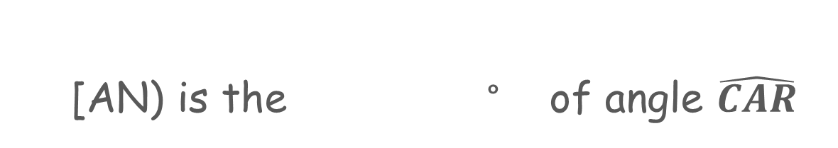

  Complete
$\hat{ CAR}=130°$ and $\hat{CAN}=65°$
$$\hat{RAN}=$$
65 °
[AN) is the ° of angle $\hat{CAR}$
bisector
$\hat{RAN}=\hat{CAR}− \hat{CAN}=130°−65°=65°$
Notes:
Teacher says:
$\hat{RAN}$ = $\hat{CAR}− \hat{CAN}=130°−65°=65°$
$\hat{RAN}$ = $\hat{CAN}=65°$
So, [AN) is the bisector of angle $\hat{CAR}$
For if a semi straight line divides an angle into two equal and adjacent angles, then it is its bisector.

Slide 12

Wrap-up

Slide 13
Wrap-up
  In this chapter, we learned to:
              Recognize the bisector as an axis of symmetry of an angle.
              Construct the bisector of an angle with a protractor.
              Construct the bisector of an angle with the compass.
              Use the following property: the bisector of an angle divides it into two equal parts.
Notes:
Teacher says:
In this chapter we learned to.
Recognize the bisector as an axis of symmetry of an angle.
Construct the bisector of an angle with a protractor.
Construct the bisector of an angle with the compass.
Use the following property: the bisector of an angle divides it into two equal parts.

Slide 14
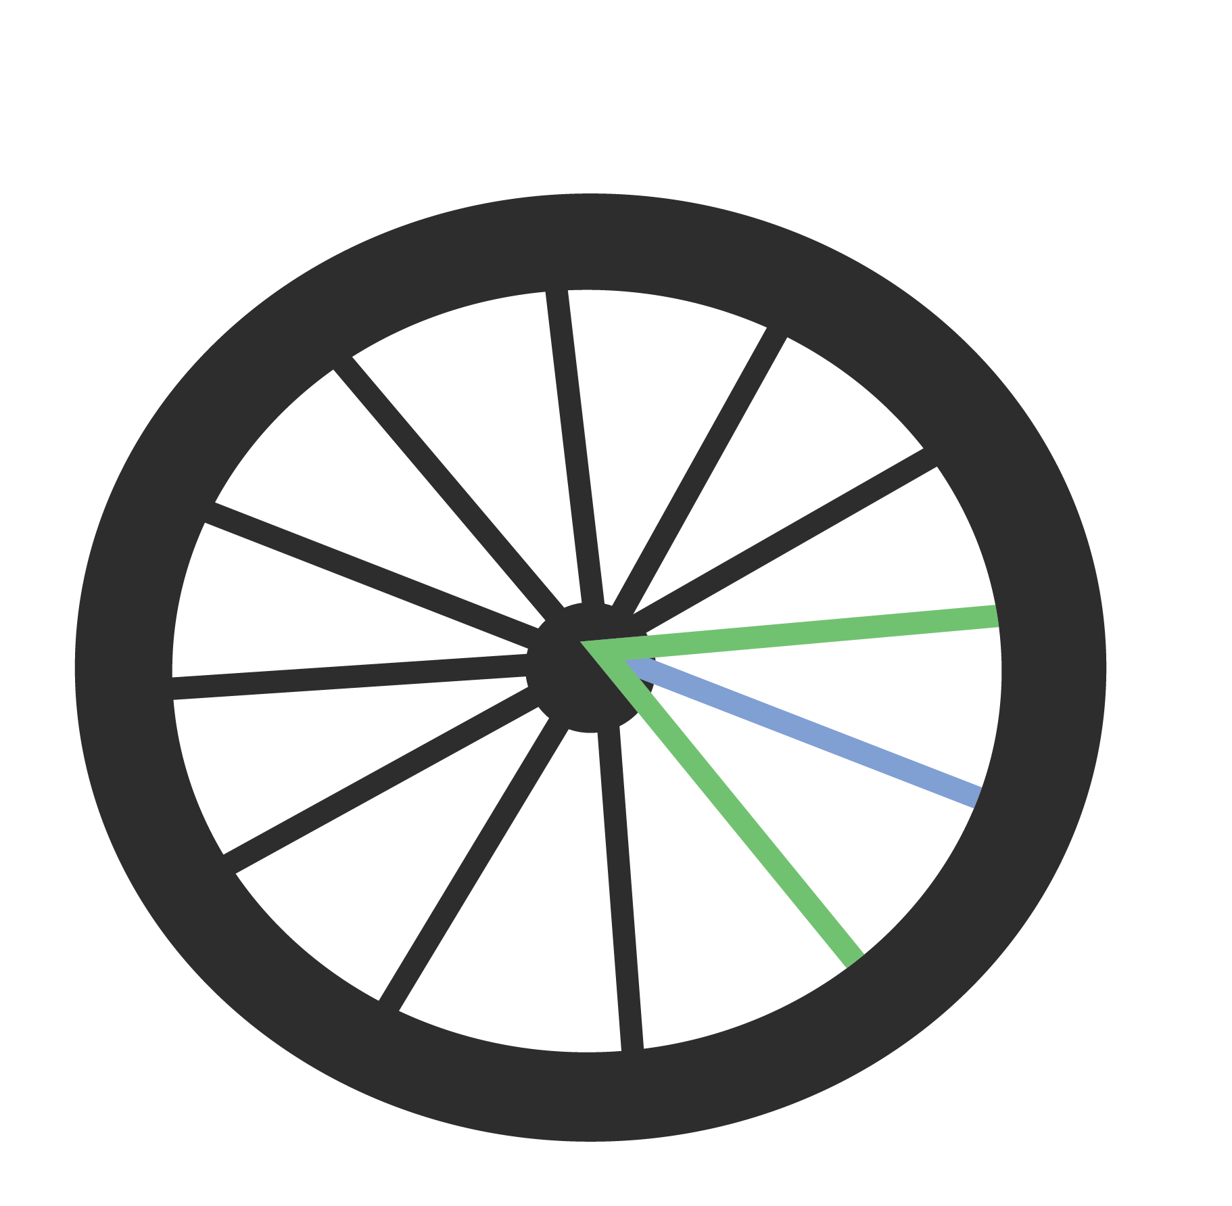
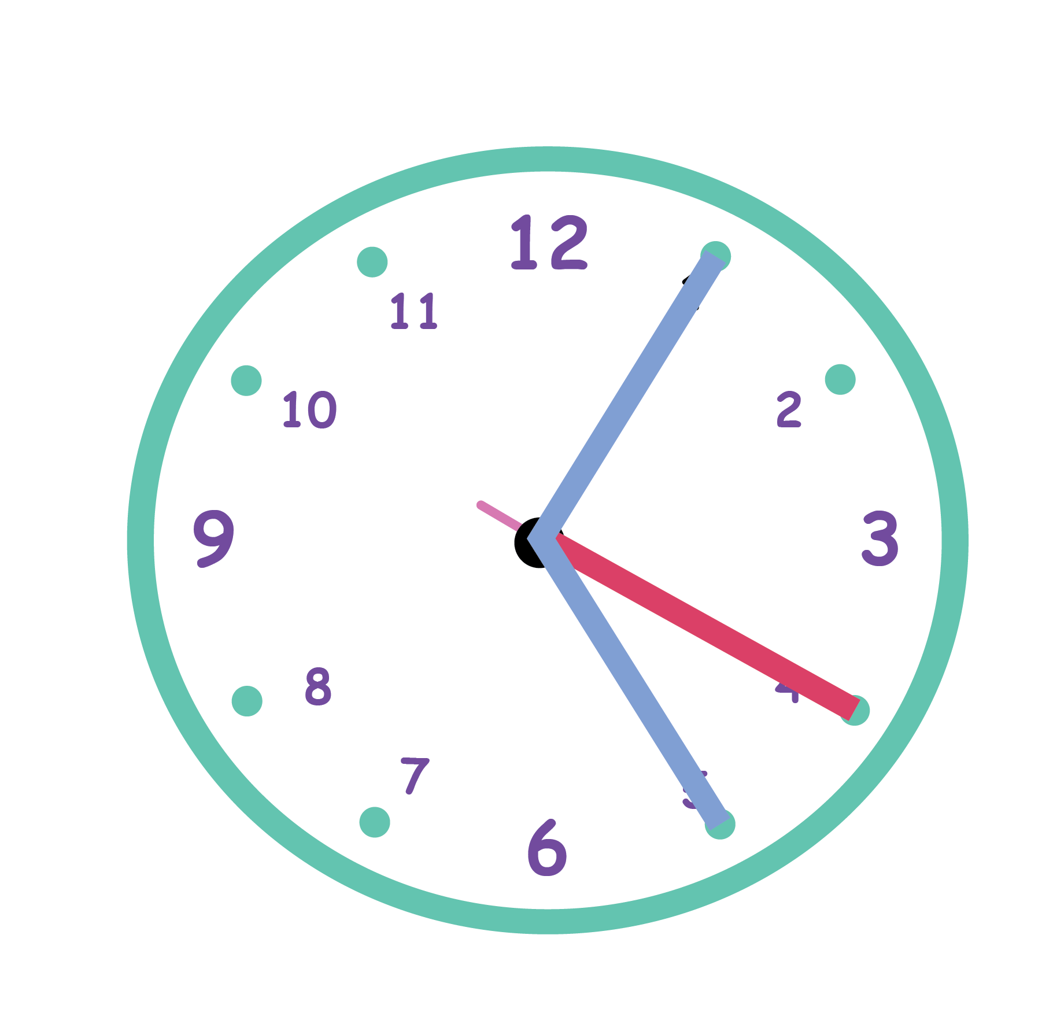
  In this chapter, we learned about the bisector of
  an angle
Notes:
Teacher says:
Now you know how the angles formed by the spokes of a wheel and those by the hands of a clock are the same and how they are different.

Slide 15
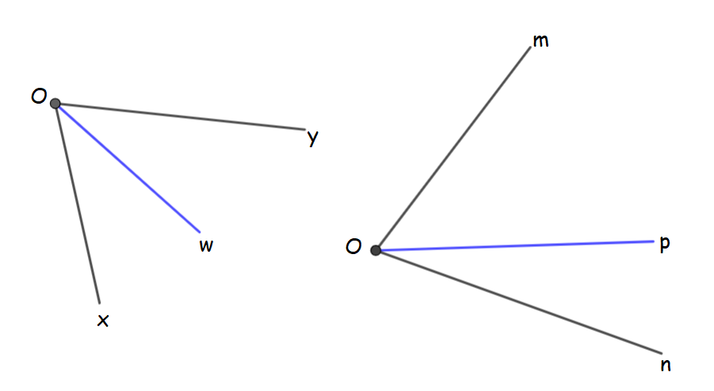

  Complete
Angles $\hat{xOw}$and $\hat{yOw}$ are
_____
and
_____
Notes:
Teacher says:
Let’s use the sketch of the angles formed by the spokes of a wheel and those by the hands of a clock and complete.

Slide 16

  Complete
Angles $\hat{xOw}$and $\hat{yOw}$ are
adjacent
and
equal
Notes:
Teacher says:
Angles $\hat{xOw}$and $\hat{yOw}$ are adjacent and equal

Slide 17

  Complete
_____
$\hat{………}$
is the bisector of angle

Slide 18

  Complete
[Ow)
$\hat{xOy}$
is the bisector of angle

Slide 19


  Complete
$$\hat{xOw}= ÷2$$
$\hat{………}$

Slide 20


  Complete
$$\hat{xOw}= ÷2$$
$\hat{xOy}$
Notes:
Teacher says:
$\hat{xOw}$ = $\hat{xOy}$ ÷ 2

Slide 21

  Is the following statement true or false?
Angles $\hat{mOp}$and $\hat{nOp}$ are adjacent.
True
False

Slide 22
  Is the following statement true or false?
Angles $\hat{mOp}$and $\hat{nOp}$ are adjacent.
True
False
Notes:
Teacher says:
Angles $\hat{mOp}$and $\hat{nOp}$ are adjacent for they have the same vertex, a common side and lie on either part of their common side

Slide 23
  Is the following statement true or false?
[Op) is the bisector of angle $\hat{mOn} .$
True
False

Slide 24
  Is the following statement true or false?
[Op) is the bisector of angle $\hat{mOn} .$
True
False

Slide 25
  Is the following statement true or false?
If $\hat{mOp}=90°$and, $\hat{nOp}=30°,$then $\hat{mOn}=120° .$
True
False

Slide 26
  Is the following statement true or false?
If $\hat{mOp}=90°$and, $\hat{nOp}=30°,$then $\hat{mOn}=120° .$
True
False

Slide 27
Summative assessment
Notes:
For the teacher:
Just for you to know that it is a summative assessment, the student only sees: Test your knowledge and the student doesn’t see the correct answers.

Slide 28
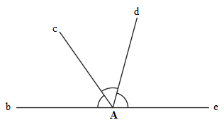
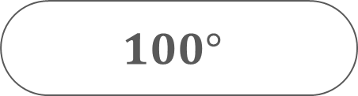
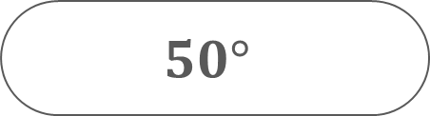
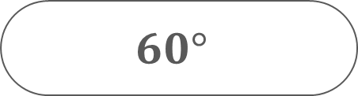
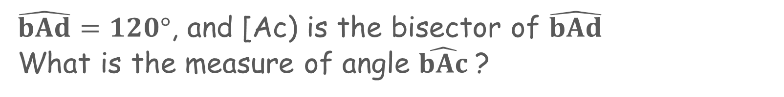
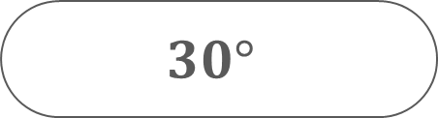
Test your knowledge
  Choose the correct answer
$\hat{bAd}=120°$, and [Ac) is the bisector of $\hat{bAd}$
What is the measure of angle $\hat{bAc}$?
d
$$60°$$
c
$$100°$$
$$50°$$
b
$$30°$$
e
A
Notes:
Teacher says:
Now it is time to test your knowledge.
Use the figure, choose the correct answer.

Slide 29

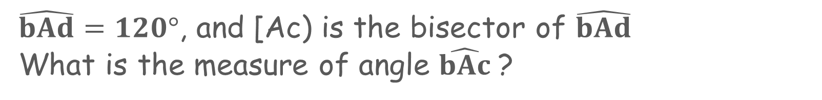
  Answer Key
$\hat{bAd}=120°$, and [Ac) is the bisector of $\hat{bAd}$
What is the measure of angle $\hat{bAc}$?
d
$$60°$$
c
$$100°$$
$$50°$$
b
$$30°$$
e
A
Notes:
Teacher says:
The bisector of an angle divides it into two equal adjacent angles.
[Ac) is the bisector of angle $\hat{bAd}$
Then $\hat{bAc}$ = $\hat{bAd}$ ÷ 2 = 120º ÷ 2 = 60$°$.

Slide 30
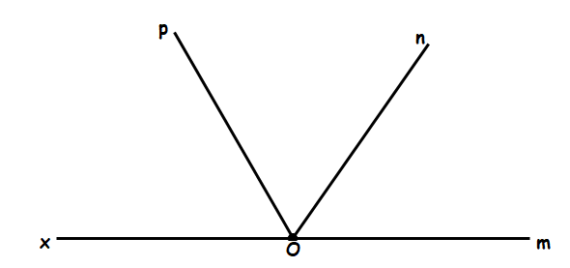
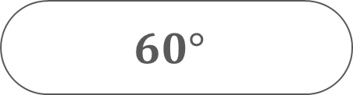
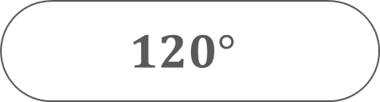
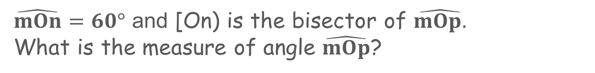
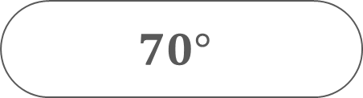
  Choose the correct answer
$\hat{mOn}=60°$ and [On) is the bisector of $\hat{mOp.}$
What is the measure of angle $\hat{mOp}$?
$$120°$$
$$60°$$
$$50°$$
$$70°$$

Slide 31

  Answer Key
$\hat{mOn}=60°$ and [On) is the bisector of $\hat{mOp.}$
What is the measure of angle $\hat{mOp}$?
$$120°$$
$$60°$$
$$50°$$
$$70°$$
Notes:
Teacher says:
The bisector of an angle divides it into two equal adjacent angles.
[On) is the bisector of angle $\hat{mOp}$ and $\hat{mOn}. =60°$
Then $\hat{mOp}$ = $\hat{mOn}$ x 2 = 60º x 2 = 120$°$..

Slide 32
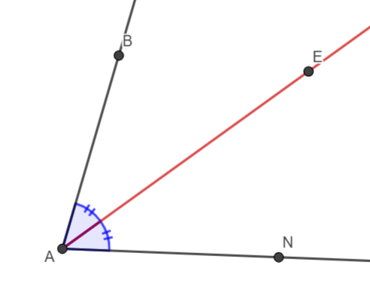
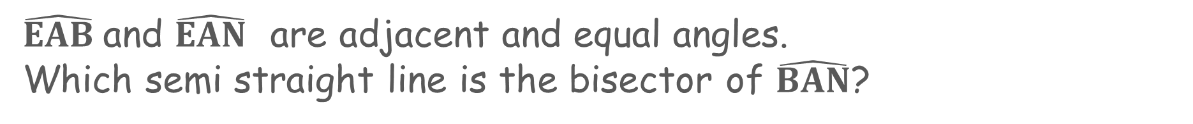
  Choose the correct answer
$\hat{EAB}$and $\hat{EAN}$ are adjacent and equal angles.
Which semi straight line is the bisector of $\hat{BAN}$?
[AB)
[AE)
[AN)
[BN)

Slide 33
  Answer Key
$\hat{EAB}$and $\hat{EAN}$ are adjacent and equal angles.
Which semi straight line is the bisector of $\hat{BAN}$?
[AB)
[AE)
[AN)
[BN)
Notes:
Teacher says:
$\hat{EAB}$ and $\hat{EAN}$ are adjacent and equal angles and their common side is [AE) so [AE) is the bisector of angle $\hat{BAN}$.

Slide 34
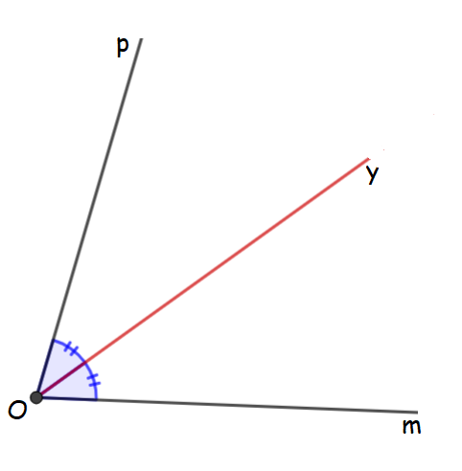
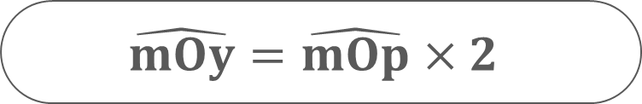
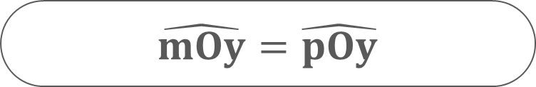
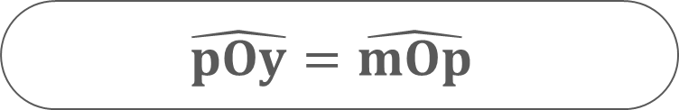
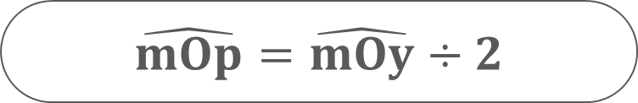
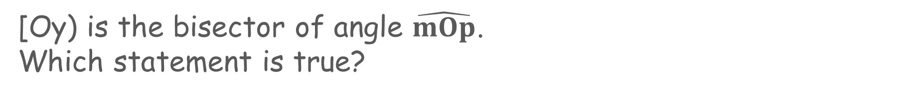
  Choose the correct answer
[Oy) is the bisector of angle $\hat{mOp}$.
Which statement is true?
$\hat{mOp}=\hat{mOy}÷2$
$\hat{mOy}=\hat{pOy}$
$$\hat{pOy}=\hat{mOp}$$
$$\hat{mOy}=\hat{mOp}×2$$

Slide 35

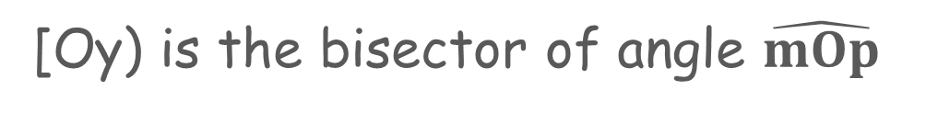

  Answer Key
[Oy) is the bisector of angle $\hat{mOp}$
$\hat{mOp}=\hat{mOy}÷2$
$\hat{mOy}=\hat{pOy}$
$$\hat{pOy}=\hat{mOp}$$
$$\hat{mOy}=\hat{mOp}×2$$
$\hat{mOy}$ = $\hat{pOy}$ = $\hat{mOp}$ ÷ 2
Notes:
Teacher says:
The bisector of an angle divides it into two equal adjacent angles.
[Oy) is the bisector of angle $\hat{mOp}$
so $\hat{mOy}$ = $\hat{pOy}$ = $\hat{mOp}$ ÷ 2

Slide 36
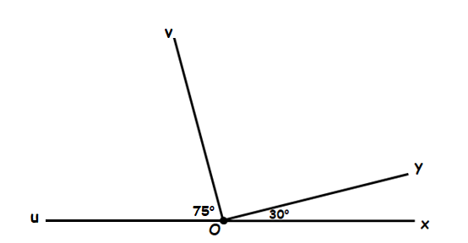
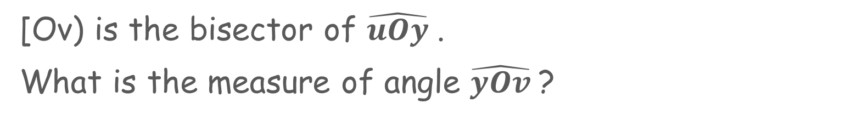
  Choose the correct answer
[Ov) is the bisector of $\hat{uOy}$.
What is the measure of angle $\hat{yOv}$?
150°
105°
75°
110°

Slide 37

  Answer Key
[Ov) is the bisector of $\hat{uOy}$
150°
105°
75°
110°
$\hat{yOv}$ = $\hat{uOv}$ $=75°$
Notes:
Teacher says:
The bisector of an angle divides it into two equal adjacent angles.
[Ov) is the bisector of angle $\hat{uOy}$
so $\hat{yOv}$ = $\hat{uOv}$ $=75°$

Slide 38
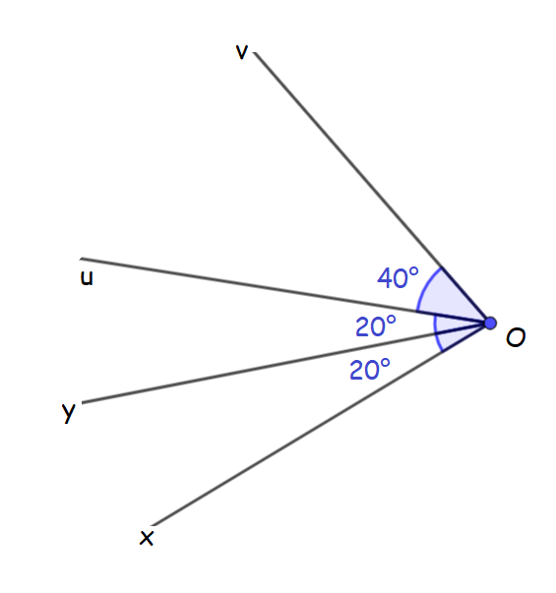


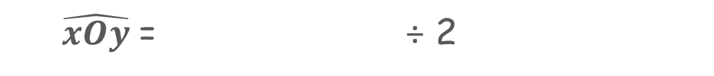
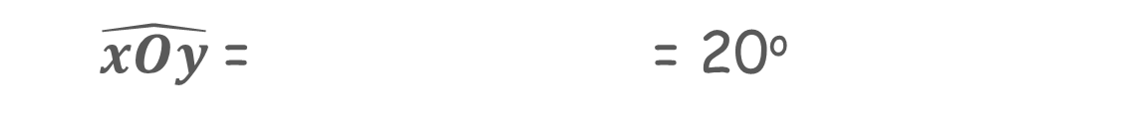

  Complete
$\hat{………}$
$\hat{xOy}$= = 20º
$\hat{………}$
$\hat{xOy}$= ÷ 2
_____
is the bisector of $\hat{xOu}$
Notes:
Teacher says:
Use the given figure to complete

Slide 39

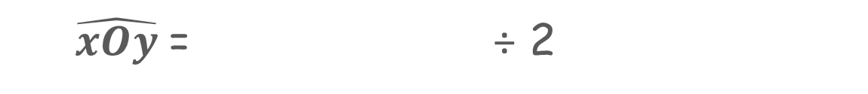



  Answer Key
$\hat{uOy}$
$\hat{xOy}$= = 20º
$\hat{xOu}$
$\hat{xOy}$= ÷ 2
[Oy)
is the bisector of $\hat{xOu}$

Slide 40


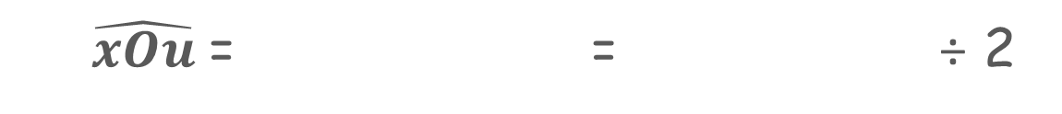
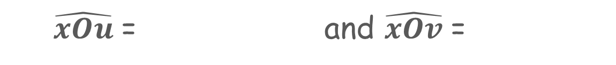

  Complete
_____ º
_____ º
$\hat{xOu}$= and $\hat{xOv}$=
$$\hat{………}$$
$$\hat{………}$$
$\hat{xOu}$= = ÷ 2
$$\hat{………}$$
[Ou) is the bisector of

Slide 41





  Answer Key
40 º
80 º
$\hat{xOu}$= and $\hat{xOv}$=
$$\hat{uOv}$$
$$\hat{xOv}$$
$\hat{xOu}$= = ÷ 2
$$\hat{xOv}$$
[Ou) is the bisector of

Slide 42
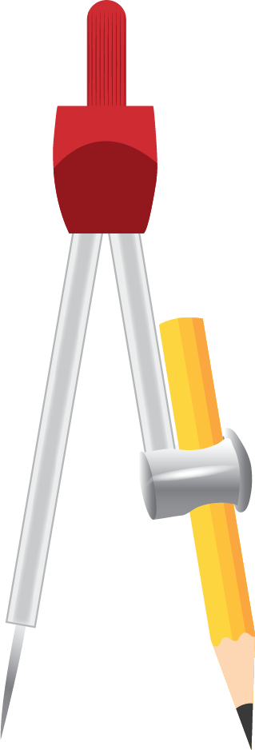
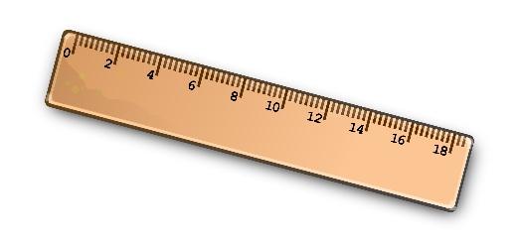

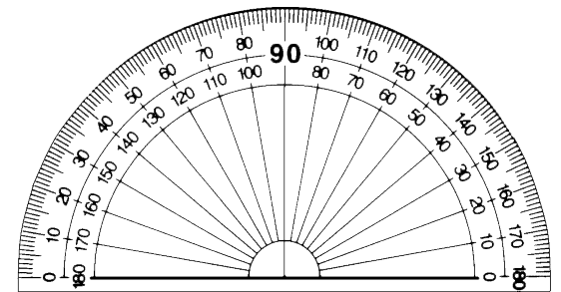
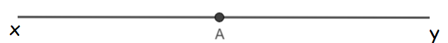
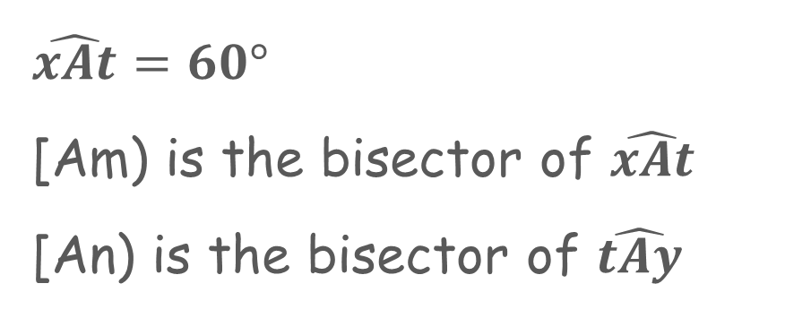
Draw using the compass, ruler, pencil, and protractor
$\hat{xAt}=60°$
[Am) is the bisector of $\hat{xAt}$
[An) is the bisector of $\hat{tAy}$
Notes:
Teacher says:
Given point A on straight line (xy)
Use the instruments in the toolbox to
1) Draw semi straight line [At) such that $\hat{xAt}=60°$
2) Draw the respective bisectors [Am) and [An) of angles $\hat{xAt}$and $\hat{tAy}$
For the teacher:
The student can use the compass or the protractor to construct the bisectors of the angles.

Slide 43

  Answer Key: using protractor and compass
Notes:
Teaching suggestion:
Play the video in slide show mode to show the construction steps.

Slide 44

  Answer Key: using protractor only
$\hat{xAm}=\hat{tAm}=30°$
$\hat{tAy}=180°−60°=120°$
$\hat{yAn}=\hat{tAn}=60°$
Notes:
Teacher says:
[Am) bisector of angle $\hat{xAt}$ so $\hat{xAm}= \hat{tAm}=30°$
$$\hat{tAy}=180°−60°=120°$$
[An) bisector of angle $\hat{yAt}$ so $\hat{yAn}= \hat{tAn}=60°$
$$\hat{mAn}= \hat{tAn} + \hat{tAm} =60°+30°=90°$$
$$\hat{xAt}= \hat{tAn}=60°$$
[At) is the bisector of angle $\hat{xAn}$

Slide 45


  Complete
__º
$\hat{mAn}$=
$$_________$$
[At) is the of angle $\hat{xAn} .$
Notes:
Teacher says:
Use your figure and complete
Find the measure of angle $\hat{mAn}$
What does [At) represent for angle $\hat{xAn}$?

Slide 46


  Answer Key
90º
$$\hat{mAn}=60°+30°=$$
$\hat{xAt}=\hat{tAn}=60°$
bisector
[At) is the of angle $\hat{xAn} .$
Notes:
Teacher says:
[Am) bisector of angle $\hat{xAt}$ so $\hat{xAm}= \hat{tAm}=30°$
$$\hat{tAy}=180°−60°=120°$$
[An) bisector of angle $\hat{yAt}$ so $\hat{yAn}= \hat{tAn}=60°$
$$\hat{mAn}= \hat{tAn} + \hat{tAm} =60°+30°=90°$$
$$\hat{xAt}= \hat{tAn}=60°$$
[At) is the bisector of angle $\hat{xAn}$

Slide 47


