Slide 1

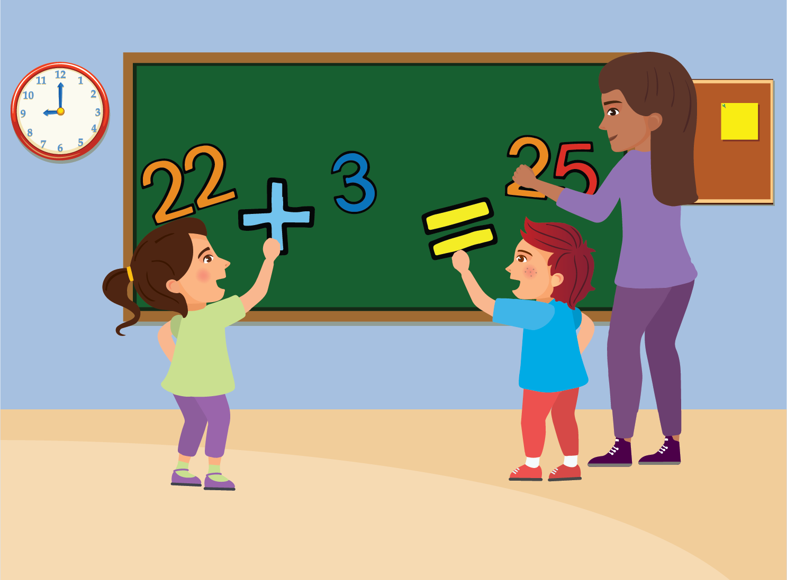

  Adding
      Grade 3 - Lesson 4
This material is made possible with the support of the American people through the United States Agency for International Development (USAID). The content is the sole responsibility of QITABI 2 and does not necessarily reflect the views of USAID or the United States Government. This material was developed by the Joint Academic Department (JAD) and the Equipment Installations and Material Support Bureau (EIMSB) at the Centre of
Educational Research and Development (CRDP) with the support of USAID-funded QITABI 2 project.

Slide 2

  Specific Learning Objective
Use the properties of commutativity and associativity of addition
Add two numbers in their expanded form
Notes:
Note for the teacher
Learning objectives as stated in the 1997 curriculum (grade 2 and 3)
Use the properties of commutativity and associativity of addition
Specific Learning Objective
Add two numbers in their expanded form.
Notes:
In lesson 4, students will discover new strategies for mental calculation based on adding ones, tens, or hundreds based on their knowledge of the expanded form of a number.

Slide 3

Math review

Slide 4
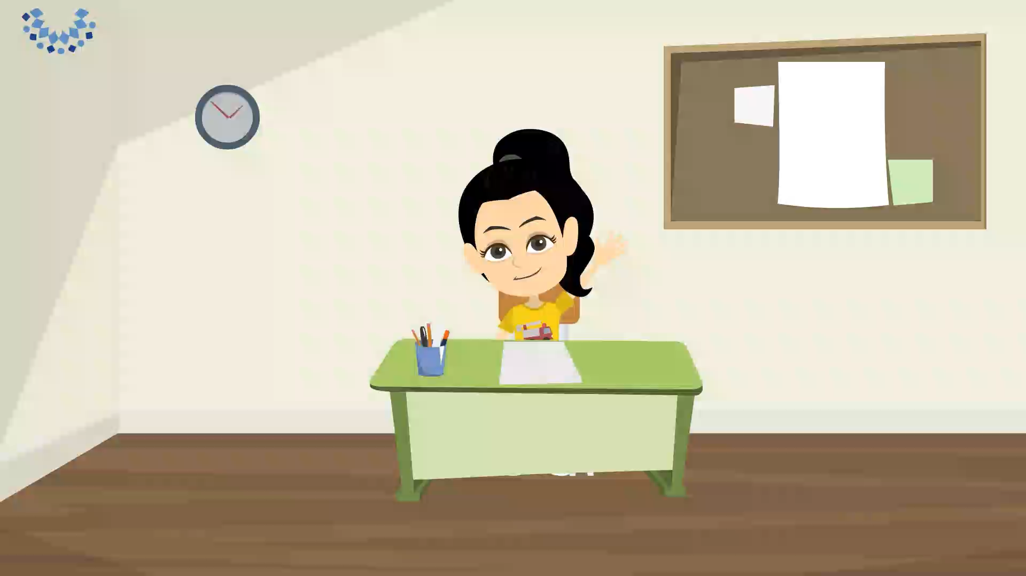
Social-Emotional Learning
  Apply focusing attention and listening skills independently
Notes:
Script of the video
Hello again.
Previously, we learned how to add numbers.
We also learned how to focus and listen carefully to instructions.
Do you remember why these skills are important?
Because together they not only improve our listening skills, but also help us work faster, more independently and with confidence.
Today, before we start our session, we'll play a game that will help us practice our listening skills some more.
Ready?
Let’s go!
I want you to listen carefully to some sentences I am about to read for you.
What you need to do is draw one of the words from each sentence you hear.
For example, if I say: “I can smell a flower”, you can draw a flower.
Ready? Let’s start:
1- My favorite fruit is a banana.
2- I go to bed at 8 o’clock.
3- I see an apple tree.
4- My favorite animal is a bear.
5- I love my mom.
Have you finished drawing?
What did you draw?
Look at all the things I drew.
Did you draw some of the same things too?
I think you have done a great job at listening carefully.
Now let’s continue with our session.
Note for the teacher
It is suggested to use an activity before starting the session that will help students apply their ability to focus and listen independently.
The words “confidence” and “independently” should be explained to students (they can be explained in Arabic)
The student can draw anything that he/she hears. There are no right or wrong answer.

Slide 5
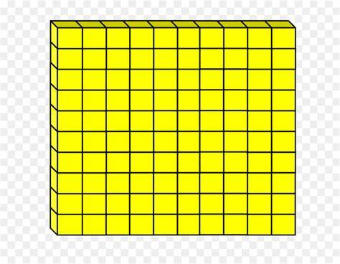
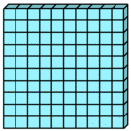
Preparatory Activity
  Place Value and base-ten blocks
3 4 2
+ 1 0 0
=
4 4 2
Notes:
Note for the teacher
In our previous sessions, we used the base-ten blocks to help us write a number in its expanded form.
We also used them to help us add numbers.
Look at this group of base-ten blocks.
We have 3 hundreds-flats, 4 tens-rods and 2 ones-cubes.
They represent the number 342.
What if we add 1 more hundreds-flat!
We will then have 4 hundreds-flats, and the numbers of tens-rods and ones-cubes will not change.
Adding a hundreds-flat represents adding a hundred to the number.
So, 342 + 100 = 442
Use the base-ten blocks (flats for hundreds, rods for tens and cubes for ones) to help students visualize and kinesthetically recognize the new strategy for mental calculation based on adding ones, tens, or hundreds. Students use these tools based on their knowledge of writing numbers in expanded form.

Slide 6

  Place Value and base-ten blocks
3 4 2
+ 3 0
=
3 7 2
Notes:
Note for the teacher
Going back to our group of base-ten blocks, again we have 3 hundreds-flats, 4 tens-rods and 2 ones-cubes. They represent the number 342.
My question for you this time is the following:
If we add 3 tens-rods to the base ten blocks, what will the number represented by the blocks become?
Well, if your answer is 372, then you are right!
In this case, only the tens’ digit has changed.
There are 3 more tens.
So, adding 3 tens to a number is the same as adding 30.

Slide 7

Understanding
Conceptual Understanding

Slide 8
Learning Activity
  Addition – Place value with base-ten blocks
124 + 260 =
384
124
260
3 hundreds
8 tens
4 ones
Notes:
Note for the teacher
Now let’s represent the number 124 using the base-ten blocks, we need 1 hundreds-flat, 2 tens-rods and 4 ones-cubes.
As for 260, we need 2 hundreds-flats and 6 tens-rods.
What do you think the sum will be if we add 124 and 260?
Let’s see. We start by grouping the blocks. We group all the ones together, then we group all the tens together, and lastly, we group all the hundreds together.
We will have 3 hundreds-flat, 8 tens-rods, and 4 ones-cubes.
So, 124 + 260 = 384
Adding 2 hundreds to a number is the same as adding 200. And adding 6 tens is the same as adding 60. Since there were no ones added, the ones’ digit does not change.

Slide 9

  Addition
1 2 4 + 2 6 0 =
?
?
4
1 2 4 + 2 6 0 =
?
8
4
1 2 4 + 2 6 0 =
3
8
4
Notes:
Note for the teacher
Now let’s check what happens when we add 260 to 124.
The ones digit does not change. It remains 4 because we do not have any additional ones.
The tens’ digit changes because we have to add 2 tens to the 6 tens. This means that we get 8 tens in all.
And lastly, the hundreds’ digit changes because we have to add 1 hundred to the two hundreds. There will be 3 hundreds in all.
3 hundreds, 8 tens and 4 ones give 384.

Slide 10

  Adding Mentally
500
550
200 + 40 + 300 + 10 =
50
Notes:
Note for the teacher
Now how can we add these numbers mentally, without feeling the need to align them vertically?
200 + 40 + 300 + 10 =
We can group the tens and add to get 5 tens or 50. We can also group the hundreds and add to get 5 hundreds or 500.
We will get 5 hundreds and 5 tens, which is 550.

Slide 11
  Addition
60
800 + 40 + 7 + 20 + 2 =
869
9
Notes:
Note for the teacher
Try to add these numbers on your own first.
800 + 40 + 7 + 20 + 2
Did you start by grouping the ones? 7 + 2 = 9 ones.
Did you then group the tens. 4 tens added to 2 tens gives 6 tens or 60.
What about the hundreds? Do we need to group them?
You’re right, we do not need to group because we have 8 hundreds only.
So, the sum is 8 hundreds, 6 tens, and 9 ones.
That is 869.
So now, do you think you can add numbers without writing them in vertical form?
All you need to do is group the ones with the ones, the tens with the tens, and the hundreds with the hundreds.
This activity helped us understand and learn how to add numbers without writing them in vertical form.
We use grouping based on the place value starting with the ones, then the tens and lastly the hundreds.
Review the activity one more time to remember how to do it.

Slide 12
Mastery of math facts
and fluency

Slide 13
Applications
  Add without using the vertical form
2 7 5 + 2 0 =
295
Notes:
Note for the teacher
Now let’s focus on these numbers. We have an addition.
First ask yourself which digit of 275 will change. Is it the ones, the tens or the hundreds? Then add.
Teacher corrects interactively
Note for the teacher
When you add 20 to a number, you are adding 2 tens.
In this case we are adding 7 tens and 2 tens to get 9 tens or 90.
The number of hundreds is still 2, and the number of ones is still 5.
So, the sum of 275 and 20 is 295

Slide 14
  Add without using the vertical form
7 1 5 + 4 0 =
755
Notes:
Note for the teacher
Now let’s focus on this new addition. Again, ask yourself which digit of 715 you think will change before you begin solving. Is it the ones, the tens or the hundreds?
Teacher corrects interactively
Note for the teacher
When you add 40 to a number, you are adding 4 tens.
In this case we are adding 1 ten and 4 tens to get 5 tens or 50.
The number of hundreds is still 7, and the number of ones is still 5.
So, the sum of 715 and 40 is 755

Slide 15
  Add without using the vertical form
4 8 2 + 3 0 0 =
782
Notes:
Note for the teacher
Here is another addition.
Think about the digits you need to add together to find the sum. Then solve.
Teacher corrects interactively
Note for the teacher
When you add 300 to a number, you are adding 3 hundreds.
In this case we are adding 4 hundreds and 3 hundreds to get 7 hundreds or 700.
The number of tens is still 8, and the number of ones is still 2.
So, the sum of 482 and 300 is 782.

Slide 16
  Add without using the vertical form
2 7 8 + 6 0 0 =
878
Notes:
Note for the teacher
Here is an addition similar to the previous one.
Think about the grouping order before completing.
Teacher corrects interactively.
Note for the teacher
When you add 600 to a number, it means that you are adding 6 hundreds.
In this case we are adding 2 hundreds and 6 hundreds to get 8 hundreds or 800.
The number of tens is still 7, and the number of ones is still 8.
So, the sum of 278 and 600 is 878.

Slide 17
  Add without using the vertical form
6 1 3 + 1 0 0 + 4 0 =
7
5
3
Notes:
Note for the teacher
Now let’s focus on this addition.
We notice that we have to add one hundred and four tens.
Remember the order in which to perform the addition, we start with the ones first, then the tens, and finally the hundreds.
Try and complete. You can do it.
Teacher corrects interactively.
Note for the teacher
Here the ones digit stays the same. We have 3 ones only.
When you add 40 to a number, you are adding 4 tens.
In this case we are adding 1 ten and 4 tens to get 5 tens or 50.
We are also adding 1 hundred to 6 hundreds. We now have 7 hundreds or 700.
So, the sum of 613, 100 and 40 is 753

Slide 18
  Add without using the vertical form
3 2 7 + 2 0 0 + 1 0 =
5
3
7
Notes:
Note for the teacher
Try this addition as well. It is similar to the previous one.
Teacher corrects interactively.
Note for the teacher
When you add 200 and 10 to a number, you add 2 to the hundreds digit and 1 to the tens digit.
So, 327 + 200 + 10 = 537
Here the ones digit stays the same. We have 7 ones only.
When you add 10 to a number, you are adding 1 ten.
In this case we are adding 2 tens and 1 ten to get 3 tens or 30.
We are also adding 2 hundreds to 3 hundreds. We now have 5 hundreds or 500.
So, the sum of 327, 200, and 10 is 537

Slide 19
  Write the sum after completing the diagram
634 + 263 =
897
+ 200
+ 60
+ 3
634
834
894
897
Notes:
Note for the teacher
You can calculate the sum easily while completing the diagram.
First add the hundreds, then the tens, and then the ones.
Teacher corrects interactively.
Note for the teacher
In this addition problem, we will add 263 to 634.
We know that 263 has 2 hundreds, 6 tens and 3 ones.
Therefore, in the diagram, we start by adding 200 to the number, then 60, and finally 3.
634 + 200 means we are adding 2 hundreds to the 6 hundreds, without changing the tens or the ones.
This gives 834.
834 + 60 means we are adding 6 tens to the 3 tens, without changing the hundreds or the ones.
This gives 894.
Lastly, adding 3 ones to 894 becomes very easy. We just need to change the ones. 4 + 3 ones is 7 ones. So, 894 + 3 gives 897.
As a result, we can see that the answer of 634 + 263 is 897.

Slide 20
  Write the sum after completing the diagram
123 + 560 =
683
+ 500
+ 60
123
623
683
Notes:
Note for the teacher
You can calculate the sum easily while completing the diagram.
First add the hundreds, then the tens to the number. You do not need to change the ones digit.
Teacher corrects interactively.
Note for the teacher
In this addition problem, we will add 560 to 123.
We know that 560 has 5 hundreds and 6 tens.
Therefore, in the diagram, we start by adding 500 to the number, and then 60.
123 + 500 means we are adding 5 hundreds to the 1 hundred, without changing the tens or the ones digits.
This gives 623.
623 + 60 means we are adding 6 tens to the 2 tens, without changing the hundreds or the ones digits.
This gives 683.
As a result, we can see that the answer of 123 + 560 is 683.

Slide 21
  Write the sum after completing the diagram
382 + 407 =
789
+ 400
+ 7
382
782
789
Notes:
Note for the teacher
Calculate the sum using this diagram.
First add the hundreds, and then the ones. You do not need to change the tens digit.
Teacher corrects interactively.
Note for the teacher
In this addition problem, we will add 407 to 382.
We know that 407 has 4 hundreds and 7 ones.
Therefore, in the diagram, we start by adding 400 to the number, and then 7.
382 + 400 means we are adding 4 hundreds to the 3 hundreds, without changing the tens or the ones digits.
This gives 782.
782 + 7 means we are adding 7 ones to the 2 ones, without changing the hundreds or the tens digits.
This gives 789.
As a result, we can see that the answer of 382 + 407 is 789.

Slide 22
  Write the sum after completing the diagram
146 + 423 =
569
+
+
+
400
20
3
146
546
566
569
Notes:
Note for the teacher
Calculate the sum by completing the diagram first.
Notice how, in the diagram, we are starting by adding the hundreds of the second number to the first number, then we move to add the tens, then the ones.
So, try your best to fill in the diagram in order to find the sum of the two numbers.
Teacher corrects interactively.
Note for the teacher
In this addition problem, we will add 423 to 146.
We know that 423 has 4 hundreds, 2 tens and 3 ones.
Therefore, in the diagram, we start by adding 400 to the number, then 20, and finally 3.
146 + 400 means we are adding 4 hundreds to the 1 hundred, without changing the tens or the ones digits.
This gives 546.
546 + 20 means we are adding 2 tens to the 4 tens, without changing the hundreds or the ones digits.
This gives 566.
Lastly, adding 3 ones to 566 becomes very easy. We just need to change the ones digit. 6 + 3 ones is 9 ones. So, 566 + 3 gives 569.
As a result, we can see that the answer of 146 + 423 is 569.

Slide 23
Common formative assessment
Notes:
Note for the teacher
This is a formative assessment. The student only hears: Check your understanding.

Slide 24
Check your understanding
  Choose the correct answer
474
374 + 100 = ______
474
384
375
Notes:
Note for the teacher
You need to focus and concentrate to choose the correct answer among the given ones.
Teacher corrects interactively.
Note for the teacher
In this addition problem, we will add a hundred to 374. This means only the hundreds’ digit changes by 1.
3 hundreds and 1 more is 4 hundreds.
That is why 374 + 100 = 474.

Slide 25
  Choose the correct answer
192
122 + 70 = ______
822
192
129
Notes:
Note for the teacher
Add 122 and 70. Think about the value of the digit 7 in 70 before completing.
Teacher corrects interactively.
Note for the teacher
In this addition problem, we will add 7 tens to 122. This means only the tens’ digit changes by 7 more.
2 tens and 7 more is 9 tens.
That is why 122 + 70 = 192.

Slide 26
  Choose the correct answer
693
463 + 200 + 30 = ______
663
693
486
Notes:
Note for the teacher
Solve 463 plus 200 plus 30. Think about the digits in the numbers and their values before completing the addition.
Teacher corrects interactively.
Note for the teacher
In this addition problem, we will add 2 hundreds and 3 tens to 463. This means only the hundreds and the tens digits will change. The ones digit will stay the same.
463 + 2 hundreds is 663.
663 + 3 tens is 693.
That is why 463 + 200 + 30 = 693.

Slide 27
  Choose the correct answer
750
400 + 20 + 300 + 30 = ______
720
450
750
Notes:
Note for the teacher
Solve the addition problem. Remember to group the digits having the same place value.
Teacher corrects interactively.
Note for the teacher
In this addition problem, we can start by grouping the tens to get 5 tens or 50, and we can group the hundreds to get 7 hundreds or 700.
That is why the sum is 700 + 50 to get 750.

Slide 28
  Choose the correct answer
758
218 + 40 + 500 = ______
740
668
758
Notes:
Note for the teacher
Solve 218 plus 40 plus 500. Think about the digits in the numbers and their place values before completing the addition.
Teacher corrects interactively.
Note for the teacher
In this addition problem, we will add 4 tens and 5 hundreds to 218. This means only the tens and the hundreds digits will change. The ones digit will stay the same.
218 + 4 tens is 258.
258 + 5 hundreds is 758.
That is why 218 + 40 + 500 = 758.

Slide 29
  Choose the correct answer
796
40 + 300 + 400 + 50 + 6 = ______
396
796
756
Notes:
Note for the teacher
Solve the addition problem. Remember to group the digits having the same place value.
Teacher corrects interactively.
Note for the teacher
In this addition problem, we have only 6 ones, but we need to group respectively the tens and the hundreds.
We can start by grouping the tens to get 9 tens or 90, and we can group the hundreds to get 7 hundreds or 700.
That is why the sum is 700 + 90 + 6, which is 796.

Slide 30


