Slide 1

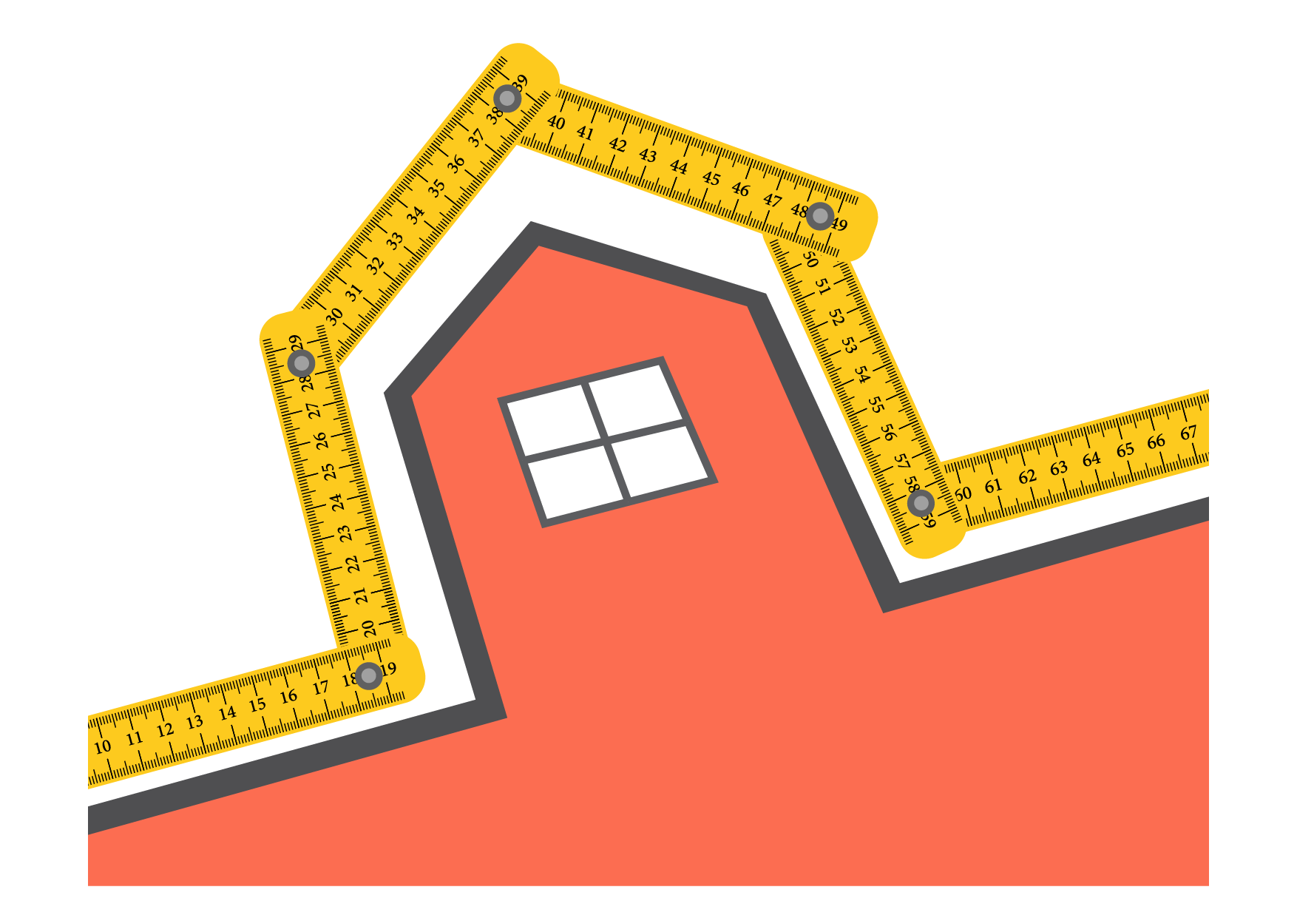
  The perimeter
      Grade 5 – chapter 8
This material is made possible with the support of the American people through the United States Agency for International Development (USAID). The content is the sole responsibility of QITABI 2 and does not necessarily reflect the views of USAID or the United States Government. This material was developed by the Centre of Educational Research and Development (CRDP) experts with the support of USAID-funded QITABI 2 project.

Slide 2

  Table of Content
1. Learning Objectives
2. Prerequisites
3. Elements of the Pedagogical Approach
4. Math Review
Check your knowledge (Diagnostic assessment)
SEL
Preparatory Activity
5. Problem Solving
6. Conceptual Understanding
Learning Activity
7. Mastery of math facts and fluency
Application(s)
8. Common formative assessment
Check your understanding
9. Wrap-up
10. Summative assessment
Test your Knowledge
Notes:
Note for the teacher
The table shows the plan of the chapter.
The chapter begins with the diagnostic assessment which aims to provide an overview of the students’ previous knowledge. The diagnostic assessment, which takes place at the start of learning, enables the teacher to learn about the students' existing knowledge and the skills they have mastered well, and to identify their difficulties.
Each chapter includes activities (which can be explicit or implicit) that promote the development of one skill (or several skills) of social and emotional learning (SEL). Social and emotional learning promotes the development of 5 fundamental skills in students: self-awareness, self-control, social awareness, interpersonal relationships, and decision-making. The role of the teacher is to integrate the objectives related to social and emotional learning in his/her teaching (activities and discussions) in class.
The flow of the session is as follows:
- An introduction which includes a preparatory question answered at the end of the chapter.
- A learning activity which includes a real-life situation that can lead students to discover new concepts while trying to solve it.
- A result of the learning activity related to the objective.
- Applications which can be exercises or problems.
For some applications, when the students fail to give a correct answer, they will be given hints, or they will be redirected to the learning activity.
- A formative assessment is carried out at the end of each session to verify students' understanding of the objectives.
A wrap-up activity is given at the end based on the chapter’s objectives.
A summative assessment is given at the end of the chapter to verify students' understanding of the chapter objectives.
Note: For students, the summative assessment is found under the title "test your knowledge".

Slide 3
  Learning Objectives
Length of a circle
Find the perimeter of a rectangle and of a square
                Calculate the side of a square, knowing its perimeter
                Calculate one of the dimensions of a rectangle, knowing its perimeter and the other dimension
Notes:
Note for the teacher
Learning objective as stated in the 1997 curriculum and the teacher’s guide
Find the perimeter of a rectangle and of a square
Specific Learning Objectives
Calculate the side of a square, knowing its perimeter
Calculate one of the dimensions of a rectangle, knowing its perimeter and the other dimension

Slide 4
  Prerequisites
Find the perimeter of a figure
              Perform conversions from one unit of length to another
Notes:
Notes for the teacher
The diagnostic assessment that takes place at the beginning of the chapter allows the teacher to check students’ knowledge of the prerequisites.
Students will find it under the title “Check your knowledge”.
Based on the students' results, the teacher may review some of the prerequisites with them.

Slide 5
  Elements of the Pedagogical Approach
1
2
3
General Pedagogical Approach
Mathematical Pedagogical Approach
SEL
Connectedness:
Students will relate to the lesson due to the activities that are based on real-life situations.
Inclusion:
Universal design for learning, that includes multiple ways of representing contents to students
Lessons are designed in a way to appropriately challenge students and support them in their efforts
SEL
Math review:
Diagnostic assessment (check your knowledge)
Problem solving:
An ongoing goal throughout the session
Conceptual understanding:
Learning activity
Mastery of math facts and fluency:
Applications
Common formative assessment:
Formative assessment (check your understanding)
The domain is brain building
The construct is critical thinking
The objective is: Identify tools to manage time better, demonstrate an ability to set priorities.
Notes:
General Pedagogical approach:
Connectedness: Students will relate to the lesson due to the activities are based on real life situations.
Inclusion: Universal design for learning, that includes multiple ways of representing contents to students such as images, oral and written responses, videos, etc.
Also, lessons are designed in a way to appropriately challenge students and support them in their efforts
SEL: students are trained in this chapter to Identify tools to manage time better, demonstrate an ability to set priorities. You can train the students throughout the lesson to manage their time by including in your instructions the time assigned to each task.

Slide 6
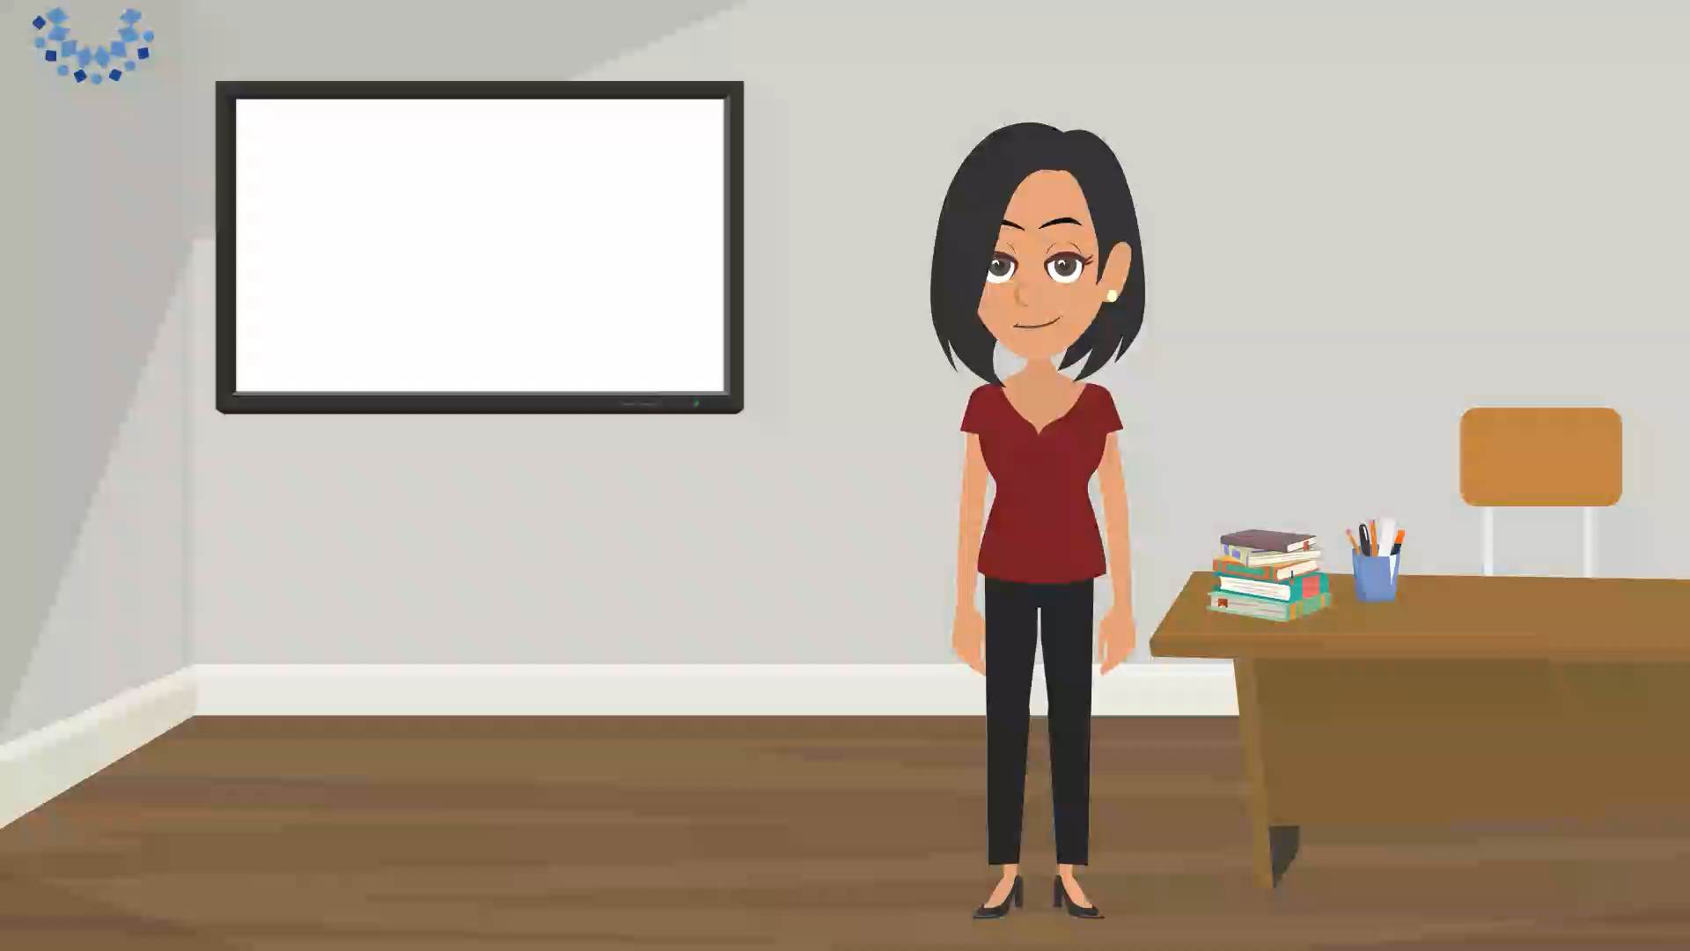
Social-Emotional Learning
  Importance of time
Notes:
Video script
Remember what we discussed in the previous lesson about the importance of time? The time we have is limited every day, and it is very important to train ourselves to manage our time well and finish our tasks on time. When you better manage your time, you will be able to be more productive, meet your deadlines, and you’ll find yourself getting far more work done with less time. This will also give you more free time to spend with your family and friends and will have a positive impact on your relationships.
Throughout our lesson, we are going to practice finishing assignments on time.
There will be a predetermined amount of time set to complete every activity.
You will see a timer on the screen with that set amount of time. You need to try to finish each activity within the set amount of time.
Note for the teacher
In class, you can reinforce this construct by giving the students a limited time to complete each assignment and by making sure you set a timer that the students can see while working on that assignment. While the timer is on, the students should focus on completing the task at hand. They might not be always able to complete the assignment within the time allocated but reminding them of the time they must work on the assignment will allow them to stay aware of the time and will encourage them to develop their ability to finish a task within a given time. Try to make sure that the tasks assigned will take almost the entire time to be completed.
Through practiced exercises, you can help students learn tangible ways to manage their time independently, rather than stressing them to get things done on time. Pay attention not to punish/scold students for not being able to finish things on time. It is a strategy that never works. The goal is to help children build internal self-discipline and a capacity to manage themselves, not only in the academic context, but in their lives. This is about building a set of skills over time, incrementally. Also remind students of the skills they learned in the previous lesson “setting priorities to achieve a better time management”. This skill can be reinforced while solving problems, in prioritizing the tasks to do and processing the information given.

Slide 7

Math review

Slide 8


Check your knowledge
  Select the correct answer
6 m 50 cm is equal to:
650 cm
6 050 cm
60 050 cm
Notes:
Teacher's note
Select the correct answer.

Slide 9
  Select the correct answer
20 km 6 m is equal to:
206 m
2 006 m
20 006 m
Notes:
Teacher's note
Select the correct answer.

Slide 10
  Complete
76
760 dm = m
5 400
54 hm = m
98
98 000 m = km
130
13 cm = mm
Notes:
Teacher's note
Complete.

Slide 11

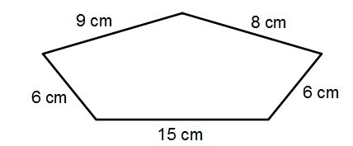
  Find the perimeter of the figure
44
The perimeter of the figure is cm.
Notes:
Teacher's note
Find the perimeter of the figure.

Slide 12
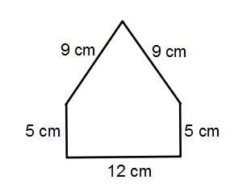
  Find the perimeter of the figure
40
The perimeter of the figure is cm.
Notes:
Teacher's note
Find the perimeter of the figure.

Slide 13
  Specific Learning Objective
Length of a circle
Find the perimeter of a rectangle and of a square
                Calculate the side of a square, knowing its perimeter
Notes:
Note for the teacher
Learning objective as stated in the 1997 curriculum and the teacher’s guide
Find the perimeter of a rectangle and of a square
Specific Learning Objective
Calculate the side of a square, knowing its perimeter

Slide 14
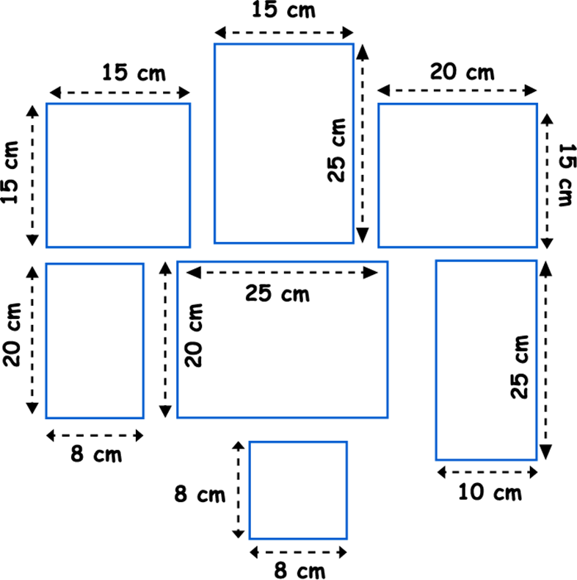
Problem solving
  Problem solving
Karim plans to paint frame borders on the wall of his room as shown in the figure. He needs 1 tube of black paint for every 100 cm of length of frame borders.
How many tubes of paint does he need to buy?
Notes:
Teacher's note
Karim plans to paint frame borders on the wall of his room as shown in the figure. He needs 1 tube of black paint for every 100 cm of length of frame borders. How many tubes of paint does he need to buy?
Let’s pay attention to our lesson to become able to solve this problem.
(Don’t give the students the chance to solve this problem now. They will do it as a wrap-up)

Slide 15
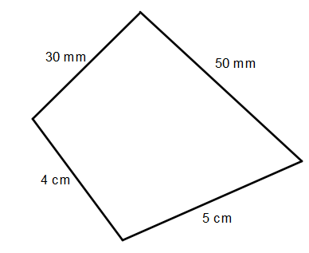
Preparatory Activity
  Complete
The perimeter of the figure is mm.
Notes:
Teacher's note
As we have learned in grade 4, the distance around a closed shape is called the perimeter.
To find the perimeter of a geometric figure, we add the lengths of all its sides.
Can you try to find, in millimeters, the perimeter of the figure shown on the screen?

Slide 16
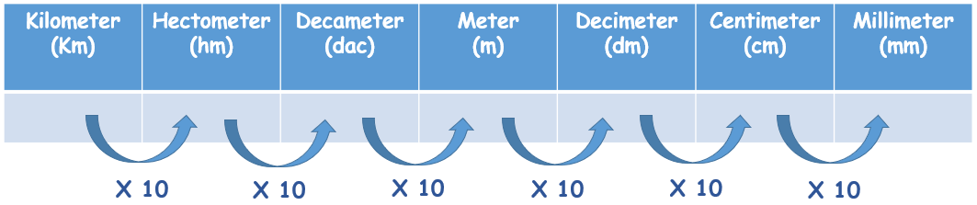
  Complete
4 centimeters = 40 millimeters
5 centimeters = 50 millimeters
Notes:
Teacher's note
First, we must make sure that all the side lengths are expressed in the same unit!! In our case, we need to express all side lengths in millimeters.
To do that, let us look first at the conversion table.
So, to convert from centimeters to millimeters, we multiply by 10.
5 centimeters is equal to 5 times 10 millimeters, so it is equal to 50 millimeters. And 3 centimeters is equal to 3 times 10 millimeters, so it is equal to 30 millimeters.

Slide 17
  Complete
P =
50 mm +
30 mm +
40 mm +
50 mm =
170 mm
The perimeter of the figure is mm.
170
Notes:
Teacher's note
Then we add the measures of all sides.
So, the perimeter of the figure is 50 millimeters plus 30 millimeters plus 40 millimeters plus 50 millimeters, which is equal to 170 millimeters.
So, the perimeter of the figure is 170 millimeters.
Note for the teacher
You can solve with the students exercises 1 and 6 on page 57 of the book.

Slide 18

Understanding
Conceptual Understanding

Slide 19
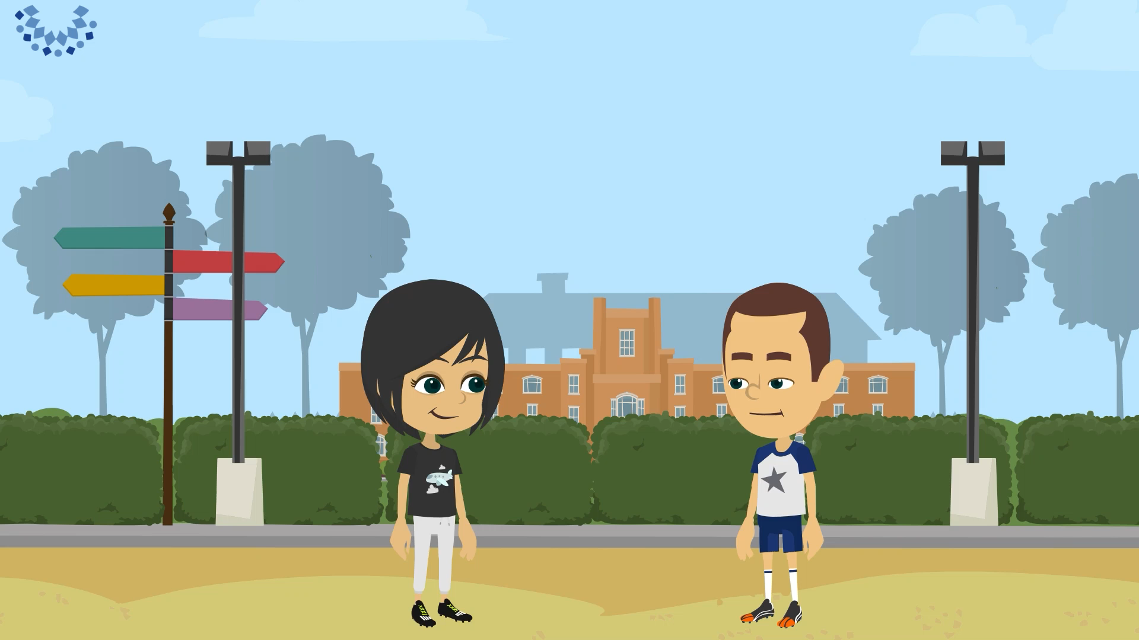
Learning Activity
  Learning activity
Notes:
Video Script:
Boy: “Today, I feel good. My physical education teacher made me run 1 500 meters.”
Girl: “I think I ran a longer distance today.”
Boy: “Let’s find out. We can check the dimensions of the playground on the school’s map and calculate the distance around it.”
Girl: “So, we need to find the perimeter of the playground. The length of the playground is 700 meters, and its width is 200 meters.”
Boy: “I think that, to find the perimeter of the playground, we can simply add the lengths of all of its sides.”
opposite sides of a rectangle have the same length. To find the perimeter of the playground, we should add the lengths of all 4 sides, so it must be 700 meters plus 200 meters plus 700 meters plus 200 meters, which is equal to 1 800 meters.
Oh, there must be a faster way to find the perimeter. Notice how we have 700 meters plus 200 meters added to itself? So, maybe we can add 700 meters and 200 meters, and multiply the sum by 2 to get the perimeter.”
Girl: “Yes, to find perimeter of a rectangle, we can add the length and the width and multiply the sum by 2. 1 800 is greater than 1 500, so I ran a longer distance than you today!!”

Slide 20
  Result
Perimeter of the rectangle
P= length + width + length + width
P= 2 × (Length + Width)
P= 2 × length + 2 × width
Width
Length
Half of the perimeter of the rectangle is equal to Length + Width.
Notes:
Teacher's note
We can deduce that the perimeter of a rectangle is equal to two times the sum of its length and its width.
To find half of the perimeter of the rectangle, we add the length and the width.

Slide 21
Mastery of math facts
and fluency

Slide 22
Applications
  Find the perimeter of the rectangle
8 cm
12 cm
The perimeter of the rectangle is is 40 cm.
40
Notes:
Teacher's note
Now let us start with some applications. Remember, for every task, you will have a timer and a fixed amount of time. Think about some of the rules you have already been introduced to in this session.
Focus on the subject and try to complete the task within the allocated time.
Teacher's note
The perimeter of the rectangle is given by $2×\left(8+12\right)=2×20=40$
The perimeter of the rectangle is 40 centimeters.
Note for the teacher
You can give students a set time to solve the exercise to train them to get them used to keep track of time and develop their time management skills.

Slide 23
  Select all correct answers
The perimeter of the rectangle is:
9 cm
P = 2 × 9 cm + 2 × 13 cm
P = 2 × 9 cm × 13 cm
P = 2 × 9 cm + 13 cm
13 cm
P = 2 × (9 cm + 13 cm)
P = 9 cm + 13 cm + 9 cm + 13 cm
Notes:
Teacher's note
What is the perimeter of the rectangle? Select all correct answers.

Slide 24
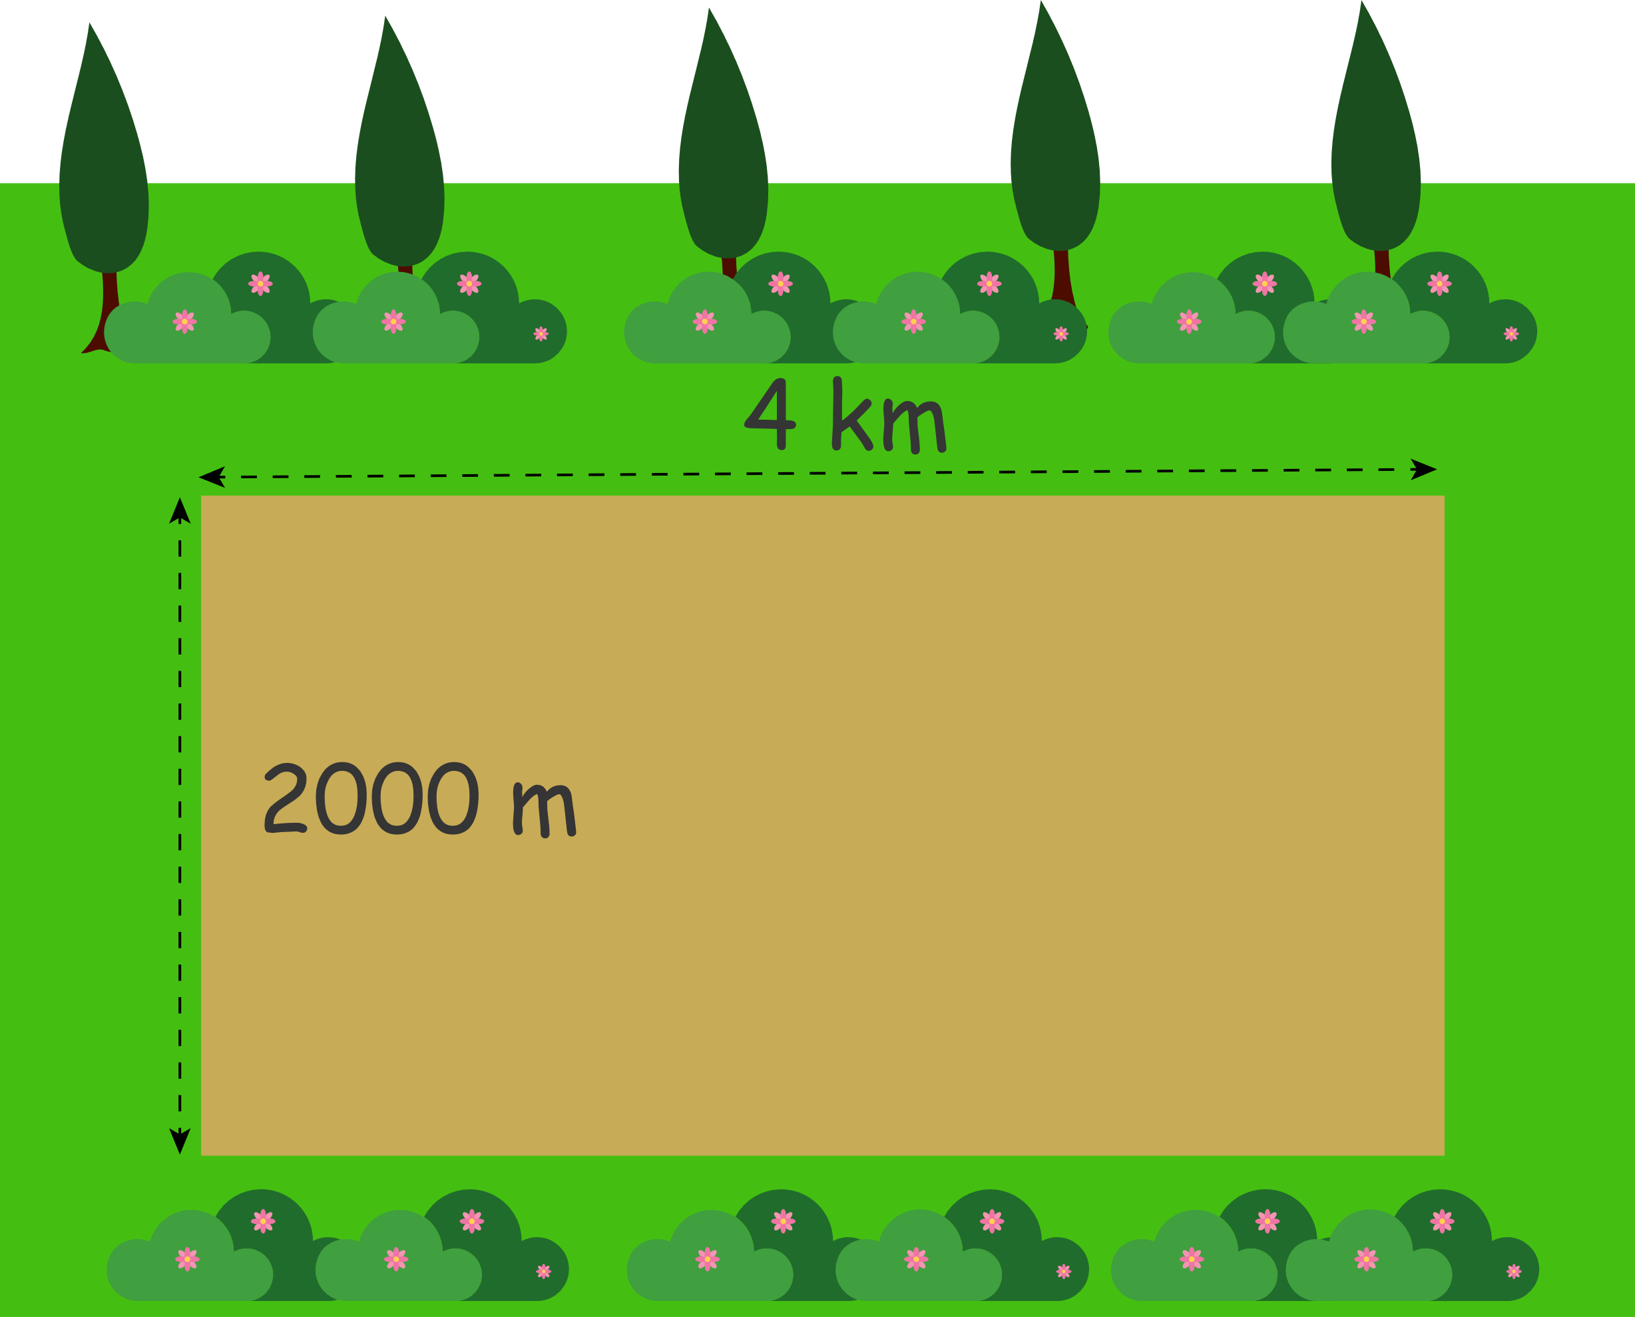
  How long is the path?
A walking path will go around the edges of a park as shown in the figure. How long, in kilometers, will the path be?
The path is km long.
12
Notes:
Teacher's note
A walking path will go around the edges of a park as shown in the figure. How long, in kilometers, will the path be?
Teacher's note
2 000 m = 2 km
The perimeter of the rectangle is 2 x 2 km + 2 x 4 km = 12 km.
Note for the teacher
You can give students a set time to solve the exercise to train them to get them used to keep track of time and develop their time management skills.

Slide 25
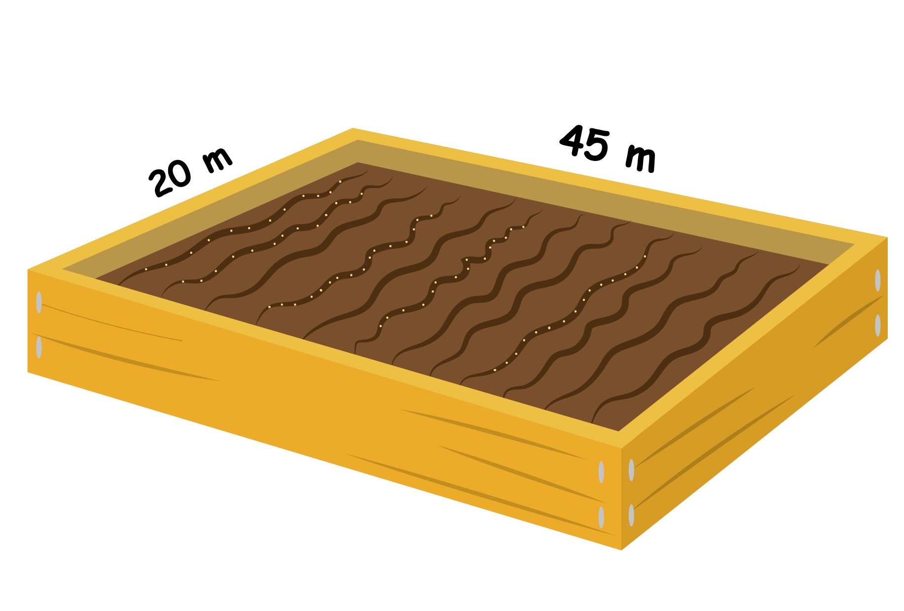
  Find the perimeter
A rectangular garden is 45 meters long and 20 meters wide. It is surrounded by a fence as shown in the figure.
Find the perimeter of the fence surrounding the garden.
The perimeter is meters.
130
Notes:
Teacher's note
A rectangular garden is 45 meters long and 20 meters wide. It is surrounded by a fence as shown in the figure.
Find the perimeter of the fence surrounding the garden.
Teacher's note
The perimeter of the fence is given by $2×\left(45+20\right)=2×65=130$
The perimeter of the rectangle is 130 meters.
Note for the teacher
you can solve with students in class problems 1, 2, 6 and 8 on pages 58 and 59 of the book.
Note for the teacher
You can give students a set time to solve the exercise to train them to get them used to keep track of time and develop their time management skills.

Slide 26
Understanding
Conceptual Understanding

Slide 27
Learning Activity
  Find the perimeter of the square
7 centimeters
28
The perimeter of the square is cm.
Notes:
Teacher's note
In this activity, we are going to come up together with a formula that allows us to find the perimeter of a square. Remember, a square has four sides of equal lengths. Here is a square!
Can you find the perimeter of the square?
Teacher's note
The perimeter of the square is 28 cm.

Slide 28
  Find the perimeter of the square
The perimeter of the square is
7 centimeters
P =
7 cm +
7 cm +
7 cm +
7 cm =
28 cm
P =
4 x
7 cm =
28 cm
Notes:
Teacher's note
The perimeter of the square is
P = 7 cm + 7 cm + 7 cm + 7 cm = 28 cm
Or it can be simply found by doing 4 times 7 centimeters which would give 28 centimeters as well.
P = 4 × 7 cm = 28 cm

Slide 29
  Find the perimeter of the square
9 centimeters
36
The perimeter of the square is cm.
Notes:
Teacher's note
Let’s take another example.
Can you find the perimeter of the square?
Teacher's note
The perimeter of the square is 36 cm.

Slide 30
  Find the perimeter of the square
The perimeter of the square is
9 centimeters
P =
9 cm +
9 cm +
9 cm +
9 cm =
36 cm
P =
4 x
9 cm =
36 cm
Notes:
Teacher's note
The perimeter of the square is
P = 9 cm + 9 cm + 9 cm + 9 cm = 36 cm
Or it can be simply found by doing 4 times 9 centimeters which would give 36 centimeters as well.
P = 4 × 9 cm = 36 cm

Slide 31
  Result
Side length
Perimeter of the square P = 4 × Length of a side
Notes:
Teacher's note
So, to find the perimeter of a square, we multiply the length of its sides by 4.

Slide 32
Mastery of math facts
and fluency

Slide 33

Applications
  Find the perimeter of the square
6 cm
The perimeter of the square is cm.
24
Notes:
Teacher's note
Now, let us move to some applications. Do not forget to pay attention to the time!
Find the perimeter of the square.
Teacher's note
The perimeter of the square is given by 4 $×6=24$
The perimeter of the square is 24 centimeters.
Note for the teacher
You can give students a set time to solve the exercise to train them to get them used to keep track of time and develop their time management skills.

Slide 34
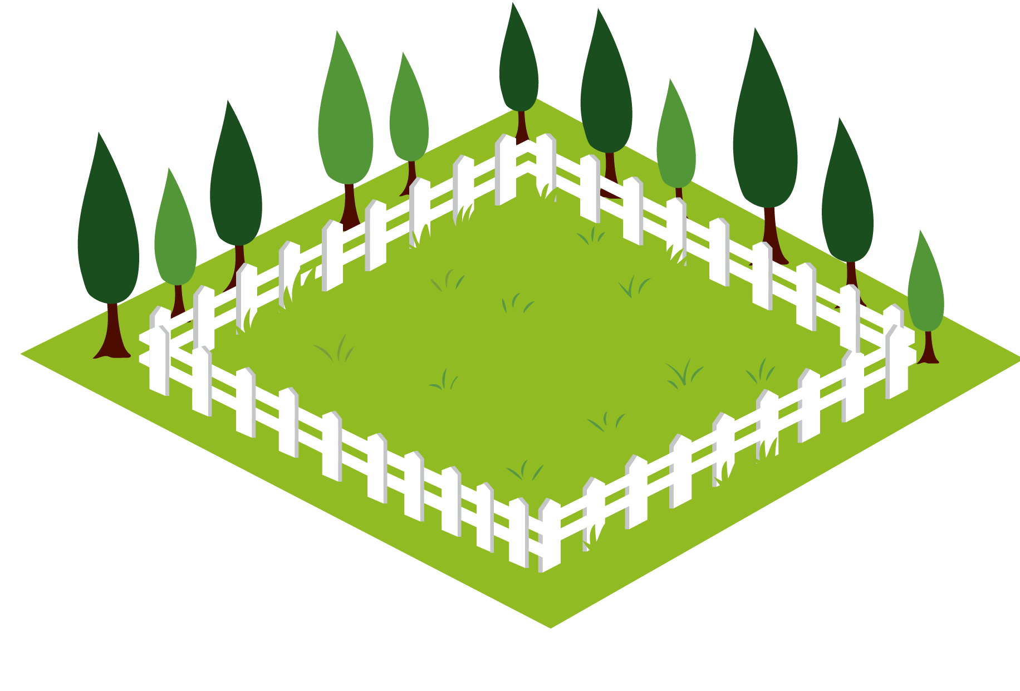
  Find the length of a side
Rawad needs to build a fence around his garden for his sheep. The garden is square, and the perimeter of the fence is 48 meters. Find the length of one side of the garden.
The side of the garden is
12
meters long.
Notes:
Teacher's note
Rawad needs to build a fence around his garden for his sheep. The garden is square, and the perimeter of the fence is 48 meters. Find the length of one side of the garden.
The side of the garden is 12 meters long.
Teacher's note
The perimeter of the square is given by 4 x length of one side
The perimeter of the square is 48 meters, so the length of a side is given by $48÷4=12$
The length of one side of the garden is 12 meters.
Note for the teacher
You can give students a set time to solve the exercise to train them to get them used to keep track of time and develop their time management skills.
You can solve with the students exercises 2 and 4 and problems 4, 7 and 9 on pages 57 to 59 of the book.

Slide 35
Common formative assessment

Slide 36

Check your understanding
  Complete
Salim glues a ribbon around the borders of the given picture to create a frame. What is the total length of ribbon that Salim uses?
20 cm
The total length of ribbon that he uses is
72
cm.
16 cm
Notes:
Teacher's note
Salim glues a ribbon around the borders of the given picture to create a frame. What is the total length of ribbon that Salim uses?
Teacher's note
The picture has a rectangular form, so its perimeter is given by $2×\left(20+16\right)=2 ×36=72$
Its perimeter is equal to 72 centimeters.

Slide 37
  Complete
A farmer wants to put a fence around his square-shaped garden. The side of the garden is 40 meters. How many meters of fencing does the farmer need?
The farmer needs
160
meters of fencing.
Notes:
Teacher's note
A farmer wants to put a fence around his square-shaped garden. The side of the garden is 40 meters. How many meters of fencing does the farmer need?
Teacher's note
The garden is square-shaped, so its perimeter is given by $4×40=160$
Its perimeter is equal to 160 meters.

Slide 38
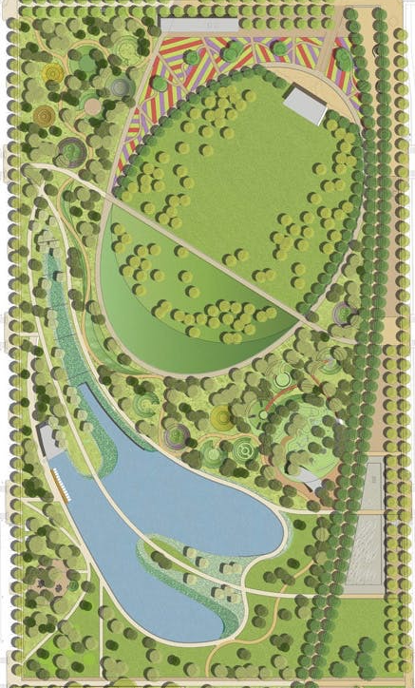
  Complete
A park shaped like a rectangle has a length of 40 meters and a width of 20 meters. If trees are planted on its sides with a gap of 10 meters between them, how many trees are needed?
12
trees are needed.
Notes:
Teacher's note
A park shaped like a rectangle has a length of 40 meters and a width of 20 meters. If trees are planted on its sides with a gap of 10 meters between them, how many trees are needed?
Teacher's note
The park has a rectangular form, so its perimeter is given by $2×\left(40+20\right)=2 ×60=120$
Its perimeter is equal to 120 meters.
The trees are planted with a gap of 10 meters between them, so there is one tree for each 10 meters of the perimeter.
The number of trees is given by $120÷10=12$
So, 12 trees are needed.

Slide 39


