Slide 1

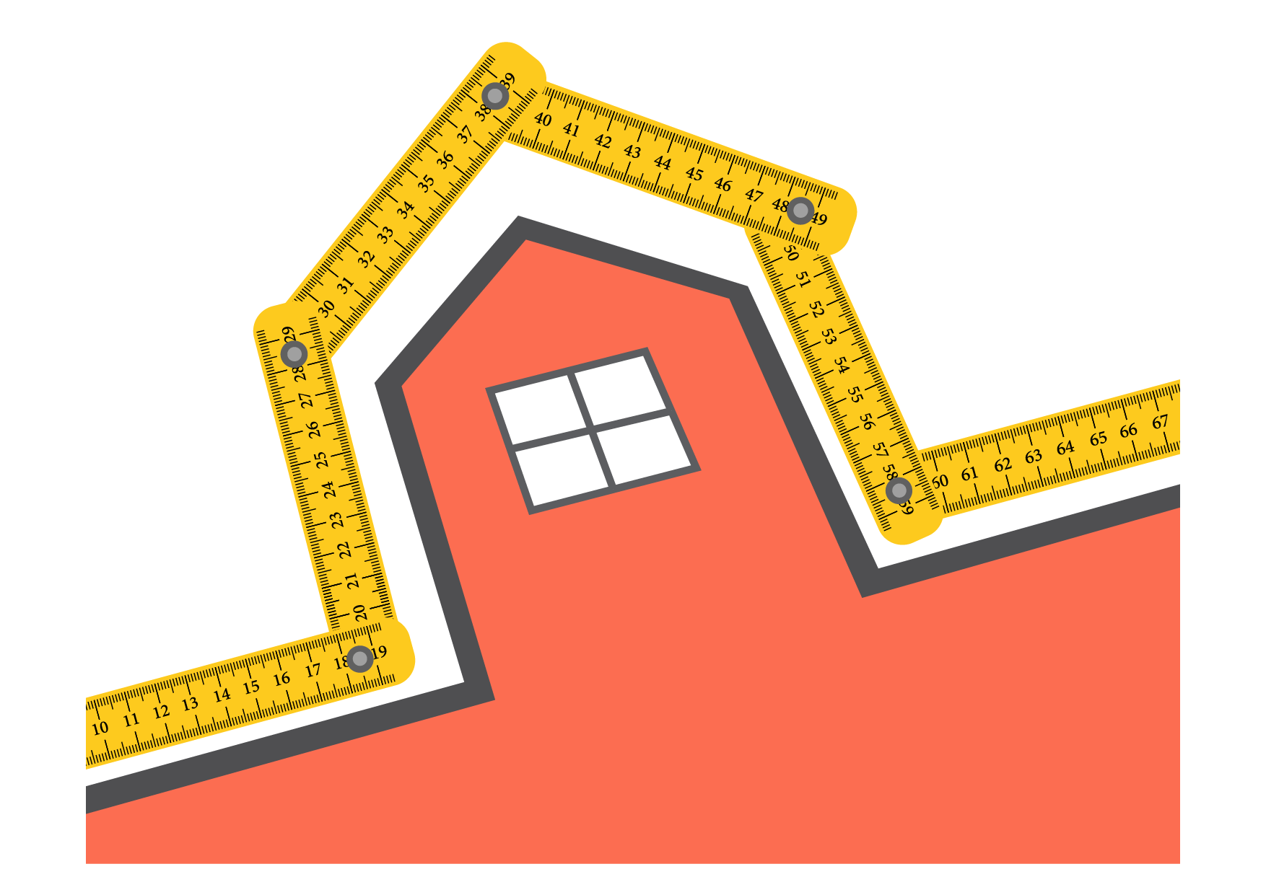
  The perimeter
      Grade 5 – chapter 8
This material is made possible with the support of the American people through the United States Agency for International Development (USAID). The content is the sole responsibility of QITABI 2 and does not necessarily reflect the views of USAID or the United States Government. This material was developed by the Centre of Educational Research and Development (CERD) experts with the support of USAID-funded QITABI 2 project.

Slide 2

  Specific Learning Objective
Length of a circle
Find the perimeter of a rectangle and of a square
                Calculate one of the dimensions of a rectangle, knowing its perimeter and the other dimension
Notes:
Note for the teacher
Learning objective as stated in the 1997 curriculum and the teacher’s guide
Find the perimeter of a rectangle and of a square
Specific Learning Objective
Calculate one of the dimensions of a rectangle, knowing its perimeter and the other dimension

Slide 3

Understanding
Conceptual Understanding

Slide 4
Learning Activity
  Find the width of the rectangle
The rectangle has a perimeter of 24 cm.
Find its width.
7 cm
Width
The width of the rectangle is equal to centimeters.
5
Notes:
Teacher's note
The rectangle has a perimeter of 24 cm. Find its width.
Teacher's note
The width of the rectangle is equal to 5 centimeters.

Slide 5
  Find the width of the rectangle
Half of the perimeter is
24 ÷ 2 = cm
7 cm
12
Width
Notes:
Teacher's note
As we mentioned earlier, half of the perimeter of a rectangle is equal to the sum of its length and its width. Can you, in our case, find half of the perimeter of the rectangle?
Teacher's note
Half of the perimeter is 24 divided by 2, which is 12 cm.

Slide 6
  Find the width of the rectangle
7 cm + width = 12 cm
Width = cm - cm
= cm
7 cm
12
7
5
Width
Notes:
Teacher's note
however, half of the perimeter of the rectangle is equal to the sum of its length and its width. So, 7 centimeters added to the width of the rectangle is equal to 12 centimeters.
Can you now find the width of the rectangle?
Teacher's note
So, the width of the rectangle is 12 centimeters minus 7 centimeters, which is equal to 5 centimeters.

Slide 7
  Find the length of the rectangle
The rectangle has a perimeter of 30 cm.
Find its length.
Length
The length of the rectangle is equal
to centimeters.
10
5 cm
Notes:
Teacher's note
The rectangle has a perimeter of 30 cm. Find its length.
Teacher's note
The length of the rectangle is equal to 10 centimeters.

Slide 8
  Find the length of the rectangle
Half of the perimeter is
30 ÷ 2 = cm
Length
15
5 cm
Notes:
Teacher's note
As we mentioned earlier, half of the perimeter of a rectangle is equal to the sum of its length and its width. Can you, in our case, find half of the perimeter of the rectangle?
Teacher's note
Half of the perimeter is 30 divided by 2, which is 15 cm.

Slide 9
  Find the length of the rectangle
Length + 5 cm = 15 cm
Width = cm - cm
= cm
Length
15
5
10
5 cm
Notes:
Teacher's note
however, half of the perimeter of the rectangle is equal to the sum of its length and its width. So, the length of the rectangle added to 5 centimeters is equal to 15 centimeters.
Can you now find the length of the rectangle?
Teacher's note
So, the length of the rectangle is 15 centimeters minus 5 centimeters, which is equal to 10 centimeters.

Slide 10
  Result
Length
Width
Length = half of the perimeter – Width
Notes:
Teacher's note
The length of the rectangle is equal to half of the perimeter minus the width, and the width of the rectangle is equal to half of the perimeter minus the length.

Slide 11
Mastery of math facts and fluency

Slide 12

Applications
  Find the length of the rectangle
Knowing that the rectangle has a perimeter of 100 cm, find its length.
33
Length
Length = cm
17 cm
Notes:
Teacher's note
Knowing that the rectangle has a perimeter of 100 cm, find its length.
Teacher's note
The length of the rectangle is given by $length = half of the perimeter – width$
Half of the perimeter is 50 cm.
The length of the rectangle is equal to $50−17=33$ centimeters.
Note for the teacher
You can give students a set time to solve the exercise to train them to get them used to keep track of time and develop their time management skills.

Slide 13

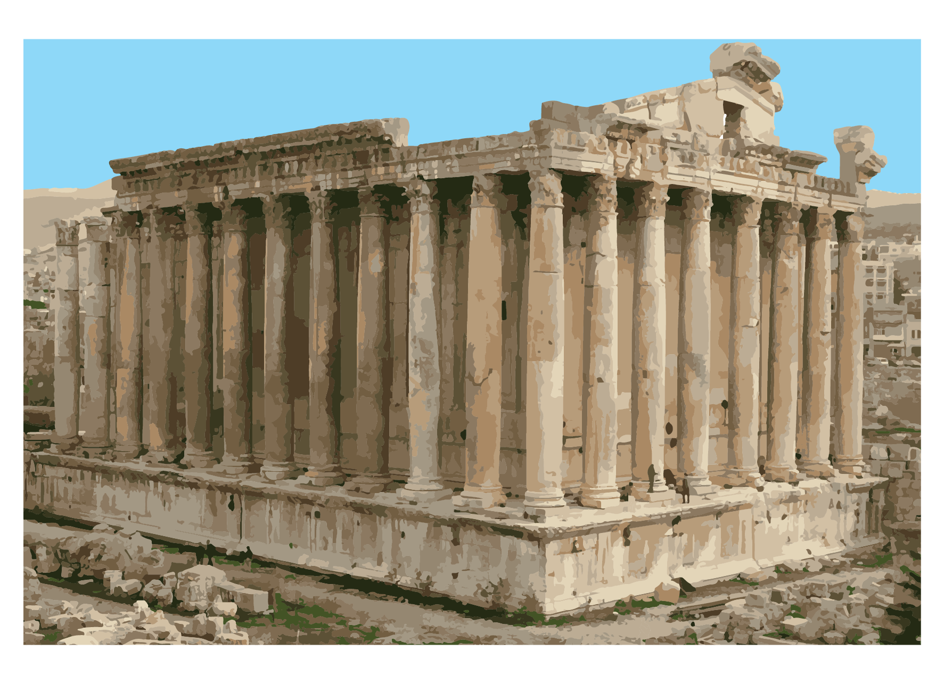
  Find the width of the temple’s base
The temple of Bacchus is part of the Baalbek temple complex. The rectangular base of the temple is 66 meters long and has a perimeter of 202 meters.
The width of the temple’s base is meters.
35
Notes:
Teacher's note
The temple of Bacchus is part of the Baalbek temple complex. The rectangular base of the temple is 66 meters long and has a perimeter of 202 meters. Find the width of the temple’s base.
Teacher's note
The width of the rectangle is given by $width = half of the perimeter – length$
Half of the perimeter of the temple’s base is $202÷2=101 m$
The width of the temple’s base is $101 – 66 = 35$meters.
Note for the teacher
You can give students a set time to solve the exercise to train them to get them used to keep track of time and develop their time management skills.
You can solve with students in class exercises 3 and 5 as well as problem 5 on pages 57 to 59 of the book.

Slide 14

Wrap-up

Slide 15
  In this lesson, we learned
How to calculate the side of a square, knowing its perimeter
How to calculate one of the dimensions of a rectangle, knowing its perimeter and the other dimension
Notes:
Teacher's note
In this lesson, we learned how to:
Calculate the side of a square, knowing its perimeter
Calculate one of the dimensions of a rectangle, knowing its perimeter and the other dimension
We also learned to Identify tools to manage time better and to demonstrate an ability to set priorities.

Slide 16
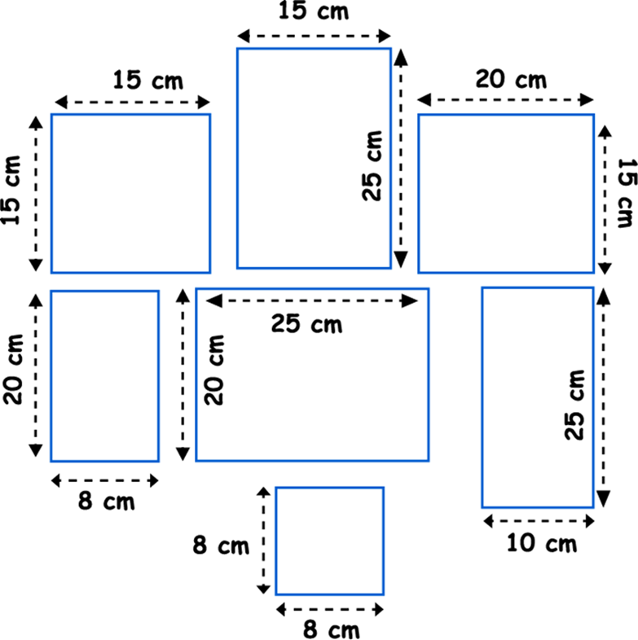
Wrap-up
  Complete
Karim plans to paint frame borders on the wall of his room as shown below. He needs 1 tube of black paint for every 100 cm of length of frame borders. How many tubes of paint does he need to buy?
Notes:
Teacher's note
Let’s go back to the problem we started with.
Karim plans to paint frame borders on the wall of his room as shown below. He needs 1 tube of black paint for every 100 cm of length of frame borders. How many tubes of paint does he need to buy?
To be able to find the number of tubes, first, we need to find the perimeter of the frames.

Slide 17
  Complete
Karim plans to paint frame borders on the wall of his room as shown below. He needs 1 tube of black paint for every 100 cm of length of frame borders. How many tubes of paint does he need to buy?
2 x (15 + 25)
4 x 15
2 x (15 + 20)
2 x (20+8)
2 x (25 + 20)
2 x (25 + 10)
The perimeter of the frames is cm.
4 x 8
458
Notes:
Teacher's note
The perimeter of the frames is given by 4 x 15 + 2 x (15 + 25) + 2 x (15 + 20) + 2 x (20 + 8) + 2 x (25 + 20) + 2 x (25 +10) + 4 x 8 = 458 cm.

Slide 18
  Complete
Karim plans to paint frame borders on the wall of his room as shown below. He needs 1 tube of black paint for every 100 cm of length of frame borders. How many tubes of paint does he need to buy?
5
Karim needs 5 tubes of paint.
Notes:
Teacher's note
Now let’s find the number of tubes of paint Karim needs to buy.
Teacher's note
Each tube can be used to paint 100 centimeters. The perimeter of the borders is 458 centimeters.
458 = 400 + 58
So, 4 tubes are needed to paint 400 centimeters, then an additional tube is needed to paint the remaining 58 centimeters. So, in all 5 tubes of paint are needed.

Slide 19
Summative assessment
Notes:
Note for the teacher
The student will find the summative assessment under the tite « test your knowledge ».

Slide 20
Test your knowledge
  Find the perimeter of the rectangle
Find the perimeter of a rectangle whose length is equal to 15 cm and whose width is 14 cm.
58
Perimeter = cm
Notes:
Teacher's note
Find the perimeter of a rectangle whose length is equal to 15 cm and whose width is 14 cm.

Slide 21
  Find the perimeter of the square
Find the perimeter of a square whose sides measure 25 mm.
100
Perimeter = mm
Notes:
Teacher's note
Find the perimeter of a square whose sides measure 25 mm.

Slide 22
  Find the amount of fencing that Farid needs to buy
Farid plans to install a fence around a cow pasture. The pasture forms a rectangle of dimensions 30 meters by 40 meters.
What is the amount of fencing that Farid needs to buy?
140
meters
Notes:
Teacher's note
Farid plans to install a fence around a cow pasture. The pasture forms a rectangle of dimensions 30 meters by 40 meters. What is the amount of fencing that Farid needs to buy?

Slide 23
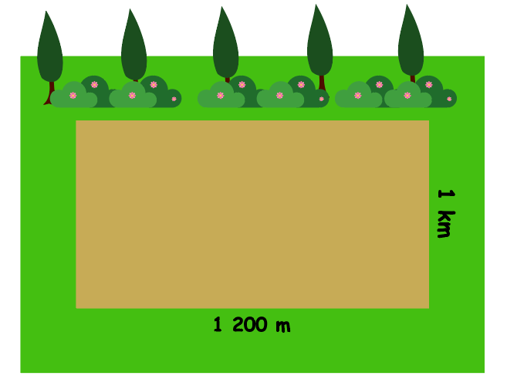
  Find the length of the path
Salma is walking around a park on the path shown below. How long, in meters, will the path be?
The path will be meters long.
4 400
Notes:
Teacher's note
Salma is walking around a park on the path shown below. How long, in meters, will the path be?

Slide 24
  Find the length of the side of the square
The perimeter of a square is equal to 48 cm.
What is the length of one side of the square?
12
Length = cm
Notes:
Teacher's note
The perimeter of a square is equal to 48 cm. What is the length of one side of the square?

Slide 25
  Complete the drawing of the rectangle
Complete the drawing of the rectangle on the grid below knowing that its perimeter is 26 units.
1 unit
Notes:
Teacher's note
Complete the drawing of the rectangle on the grid below knowing that its perimeter is 26 units.

Slide 26


